Slide 1



Accessible General Use Technologies for Faculty
Thomson, R. (2024, June 3-4). Accessible general use technologies for faculty [Conference presentation]. 13th Annual SALTISE Conference, Montreal, QC, Canada.
SALTISE – JUNE 2024
Roberta Thomson
Adaptech Research Network
Funding: Entente Canada Quebec (ECQ)

Slide 2
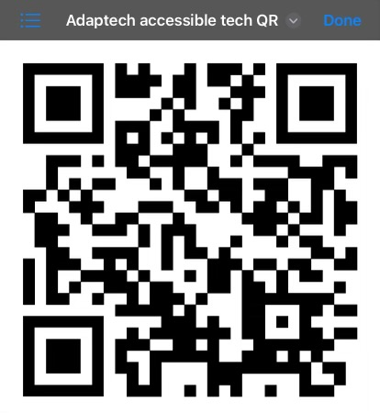
Accessible General Use Technologies for Faculty
Adaptech Webpage Videos
  Dictate in Microsoft Word,
  Using Alt Text and Check Accessibility in PowerPoint
  Making Tables Accessible in Excel
  How to use Live Captions and Transcripts in Teams
  Using Google Docs (coming)
  https://adaptech.org/research/accessible-general-use-technologies-for-faculty/

