Slide 1
Putting Research Into Practice in the College Classroom
Alice Havel, Catherine Fichten, Mary Jorgensen
In Collaboration with
L. King, J. Budd, A. Lussier, S. Jorgensen,
J. Asuncion, M.N. Nguyen, A. Chauvin
Webinar for the Dawson College Office of Academic Development

Slide 2
Who are we?
Adaptech Research Network
Team of teachers, professionals, students, researchers
Conducts research on post-secondary students with a variety of disabilities
Based at Dawson College

Slide 3
Why Watch this Clip?
Value of applied research
Solve practical problems
Provide recommendations
5 tips in 5 minutes

Slide 4
Who are your students?
16% of Dawson students self-reported a disability¹
≈ 2/3 were not registered for campus disability services²
Mainly students with
Learning disability/attention deficit hyperactivity disorder
Mental health problems
Chronic health conditions

Slide 5
Tip # 1
Provide students the opportunity to inform you of their special needs.

Slide 6
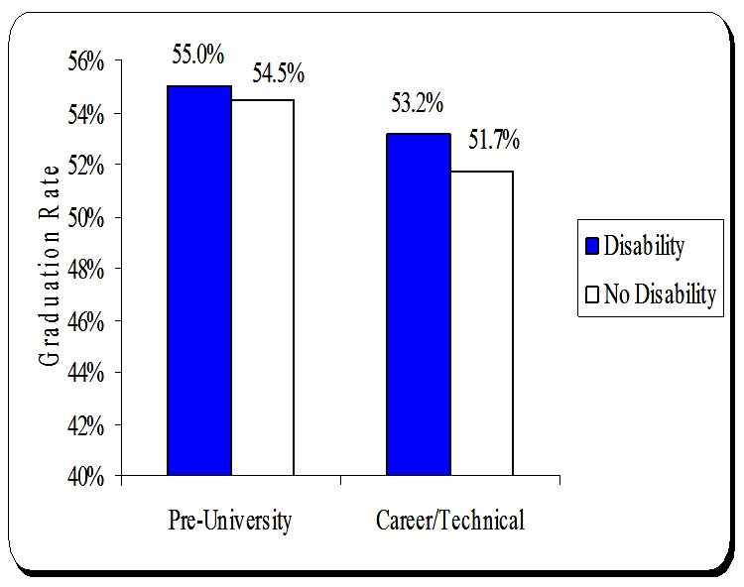
Which Students Graduate?
Dawson Students with/without disabilities graduate at the same rate³
Higher graduation rate of students with disabilities
But not significantly
Take an extra term

Slide 7
Tip # 2
Maintain the same academic standards for all students,
But demonstrate flexibility in the methods used to evaluate competencies.

Slide 8
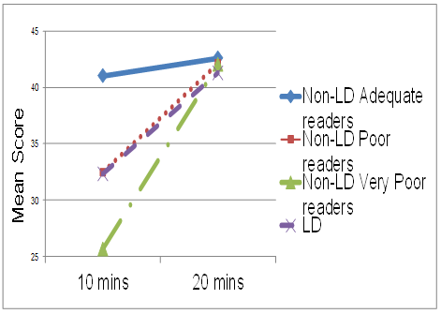
Why Extended Time on Tests?
Study of reading comprehension⁴
432 college students
LD (learning disabilities)
Poor readers
Very poor readers
Adequate readers
Mean Score on Reading Test

Slide 9
Tip # 3
Provide adequate time for all students to complete their tests, including very poor readers.

Slide 10
Do You Need to be an Expert in Technology?

Slide 11
Tip # 4
You can use simple technology, but use it well and for a pedagogical purpose.

Slide 12
Should Students be Allowed to Use Personal Technology in Class?
6

Slide 13
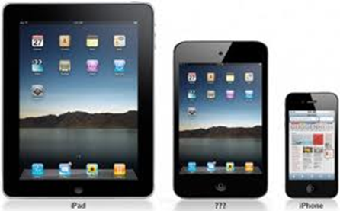
Tip # 5
Incorporate the use of personal technology into classroom activities.

Slide 14
Where can I find out more?
http://www.adaptech.org/
http://www.washington.edu/doit/
http://www.alludl.ca/

Slide 15
References
¹Fichten, C. S., Heiman, T., Havel, A., Jorgensen, M., Budd, J., & King, L. (2016). Sustainability of disability-related services in Canada - Israel: Will the real universal design please stand up? Exceptionality Education International, 26(1), 19-35.
²Fichten, C.S., Jorgensen, S., Havel, A., Barile, M., (2006). College students with disabilities: Their future and success. Final report to FQRSC. Montréal: Adaptech Research Network, Dawson College.
³ Jorgensen, S., Fichten, C.S., Havel, A., Lamb, D., James, C., & Barile, M. (2005). Academic performance of college students with and without disabilities: An archival study. Canadian Journal of Counselling, 39(2), 101-117.
⁴Fichten, C. S., Nguyen, M. N., King, L., Havel, A., Mimouni, Z., Barile, M., Budd, J., Jorgensen, S., Chauvin, A., & Gutberg, J. (2014). How well do they read? Brief English and French screening tools for college students. International Journal of Special Education, 29(1), 33-46.
⁵Jorgensen, M., Havel, A., Fichten, C., King, L., Marcil, E., Lussier, A., Budd, J., & Vitouchanskaia, C. (2017). "Simply the best" : Professors nominated by students for their exemplary technology practices in teaching. Education and Information Technologies. Advance online publication. doi:10.1007/s10639-017-9594-1
⁶Fichten, C. S., King, L., Jorgensen, M., Nguyen, M. N., Budd, J., Havel, A., Asuncion, J., Amsel, R., Raymond, R., & Poldma, T. (2015). What do college students really want when it comes to their instructors’ use of information and communication technologies (ICTs) in their teaching? International Journal of Learning, Teaching and Educational Research, 14(2), 173-191. Retrieved from http://www.ijlter.org/index.php/ijlter/article/view/522/pdf

