Slide 1
Help is on the Way: Addressing the Needs of Students with Learning Disabilities in the Classroom
Alice Havel, Ph.D.
Adaptech Research Network and Dawson College
Roberta Thomson, M.A.
Course Instructor, McGill University/LaSalle College
Institiut des troubles d’apprentissage
Montreal, Quebec
April 27, 2017

Slide 2
Agenda
Learning Disabilities (LD) Overview
Individual Education Plans (IEP)
Universal Design (UD) Paradigm
Teaching Strategies for LD
Assistive Technology (AT)
Reasonable Accommodations

Slide 3
Welcome
Icebreaker
Name, school, role
Create a story
Each person says one word
Everyone has one turn
Change of rules

Slide 4
Learning Disabilities
Learning Disability defined in:
Practical terms
Medical terms
Specific terms

Slide 5
Learning Disabilities

Slide 6
Practical Terms
Difficulty in one or more stages
Input (auditory, visual and kinesthetic perception)
Process (sequencing, abstraction, and organization)
Storage (working, short term, and long term memory)
Output (expressive language, fine and gross motor)

Slide 7
Learning Disabilities
Medical terms:
Diagnostic and Statistical Manual of Mental Disorders (DSM-V)
Neurodevelopmental Disorder
Specific Learning Disorder
One category: based on academic skills deficits

Slide 8
Learning Disabilities
Specifiers
Reading: word accuracy, rate or fluency, comprehension
Written expression: spelling, grammar and punctuation
Mathematics: number sense, arithmetic facts, fluent calculation, math reasoning

Slide 9
Learning Disabilities
Specifiers
Foundation for other academic learning
Not all children with LD meet DSM-V criteria for diagnosis

Slide 10
LD Diagnoses
Input Phase
Auditory Perception
Visual Perception
Process Phase
Executive Functioning
Information Processing Speed
Language Processing
Dyscalculia
Sensory Integration
Non-verbal Learning
Auditory Processing

Slide 11
LD Diagnoses
Output Phase
Dysgraphia
Dysnomia
Dysphasia
Dyspraxia
Storage Phase
Working memory
Short-term memory
Long-term memory
Overlapping the Phases
Dyslexia
Input Phase- visual perception of symbols
Processing Phase – phonemic awareness
Output Phase – reading, writing

Slide 12
Learning Disabilities
"A Rose by Any Name"
What matters is what something is, not what it is called.
Use of labels:
Funding
Legal obligations
Starting point

Slide 13
Learning Disabilities
What is essential:
Student’s strengths and limitations
Environmental facilitators and barriers
Component(s) of task
Functional (limitations) interaction with environment

Slide 14
Learning Disabilities and Behavioural/Emotional Problems
Anxiety https://www.youtube.com/watch?v=hZf8mfQFz-A 3:45
Others:
Avoidance behaviour
Depression
Disruptive behaviour
Familial and peer relationship problems
Notes:
Experiencing Frustration, Anxiety and Tension

Slide 15
Learning Disabilities and Behavioural/Emotional Problems
Others Cont’d
Frustration/anger
Low self-esteem
Social behaviour problems
Somatic complaints

Slide 16
Learning Disabilities and Behavioural/Emotional Problems
Is the behaviour secondary to the learning disability or co-morbid?
Does LD or Behavioural/ emotional problems cause the greatest distress? Treat that one first.
Is the student experiencing:
Learned helplessness
Cognitive overload

Slide 17
Learning Disabilities
Select 1 LD term
Prepare - a way to communicate what you know about this LD (10 min)
Express - use a flip chart, poster, PowerPoint slide, simulation, etc.
Remember you have 2 minutes to present
Be concise

Slide 18
Individualized Education Plans
MELS requirement
Roles and stakeholders
Perspective from your role
Environmental barriers
Realistic constraints
Room for change

Slide 19
Quebec IEP Research
IEP strengths:
Facilitates cooperation among players
Promotes collaboration with parents
Identifies the needs of the student
IEP difficulties:
Time management
Use of the IEP as an aid in teaching
Student’s participation
Reference 1
Notes:
http://www.education.gouv.qc.ca/fileadmin/site_web/documents/dpse/adaptation_serv_compl/19-7053_plan_presentation.pdf

Slide 20
Quebec IEP Research
Less than 1/3 of students involved
More parent participation for ‘handicaps’ than at-risk students
Reference 1

Slide 21
IEP Activity
Think-Pair-Share
Review IEP 1
Strengths and weaknesses of the IEP
Review IEP 2
Identify and analyze the differences between IEP 1 and 2
Notes:
Anything they want to change in the good IEP. There is no such thing as a good IEP. No right IEP answer.
Interactive Form, IEP requirements in QC, Riverside school board….
What will the teacher do?

Slide 22
IEPs & Goals
What are good goals?
SMART-P(positive)
John will stop avoiding math problems, 8 of 10 times by Oct. 1/17.
John will use his time/timer for 3 minutes before starting his math problems, 8 of 10 times by Oct. 1/17

Slide 23
IEPs and Learning Disabilities
Your experiences
Your challenges
Possible solutions

Slide 24
Pause/Break
10 Minutes

Slide 25
Universal Design (UD) Paradigm
Overview of basics of a universal model of curriculum design
Accessibility and supporting environmental changes

Slide 26
Universal Design (UD) Paradigm
Began in architecture
Design to maximum access for all
Concept moves to pedagogy
No average learner
Proactive planning
Beneficial for one; beneficial for many
Notes:
Image of 3 aspects of looking over fence at baseball. Video airplane pilots…
Angela –
What ever you do…is good all around…
Think of examples

Slide 27
Universal Design (UD) Paradigm

Slide 28
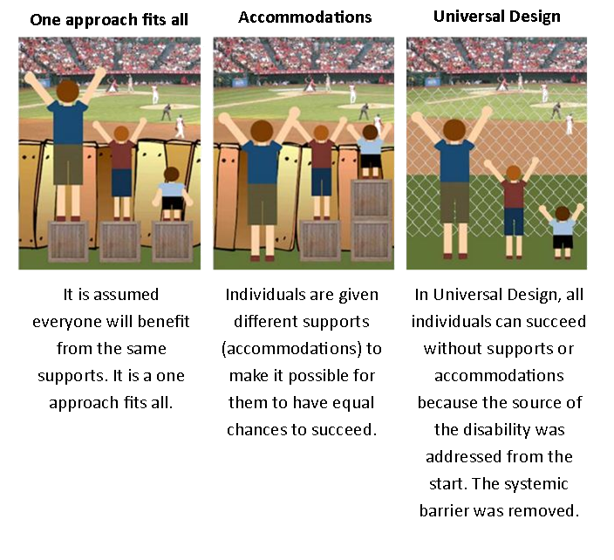
Impact of Design

Slide 29
Universal Design (UD) Paradigm
Paradigm
UNIVERSAL
DESIGN
(UD)
UNIVERSAL
DESIGN
FOR LEARNING
(UDL)
UNIVERSAL
DESIGN
OF
INSTRUCTION
(UDI)
UNIVERSAL
INSTRUCTIONAL
DESIGN
(UID)

Slide 30
Universal Design for Learning
Supports a shift away from one-size-fits-all approach with disability accommodation (medical model)
Towards up-front design for natural learner diversity

Slide 31
UDL 3 Principles
Multiple Means of Engagement
Recruiting interest
Sustaining effort and persistence
Self-regulation
Multiple Means of Representation
Perception
Language, expressions and symbols
Comprehension

Slide 32
UDL 3 Principles
Multiple Means of Action and Expression
Physical access
Expression and Communication
Executive Functions
UDL: Principles and Practice

Slide 33
Teaching Strategies
Reviewed meta-analysis of recent research on LD interventions
Originally thought specific diagnosis = specific intervention (medical model)
Moved to interventions based on functional needs

Slide 34
Teaching Strategies
What difficulties is the student encountering in performing a specific task?
Models of teaching evolve from cognitive psychology
Looked for common principles

Slide 35
Teaching Strategies
Essential Ingredients
Engage the students:
Positive approach to task
Relevance of the topic

Slide 36
Teaching Strategies
Direct instruction:
activate prior learning,
break learning into small steps,
example of the desired outcome,
allow ample time for well-designed practice,
offering hints or partial solutions to problems,
supply regular feedback

Slide 37
Teaching Strategies
Learning strategy instruction:
model the thought process for students through "think aloud" talk,
provide prompts of strategies to use, engage students in process type questions

Slide 38
Teaching Strategies
Multi-sensory approach:
Use diagrams,
Graphics and pictures to augment what they say in words,
Kinesthetic approaches

Slide 39
Case Scenarios
Instructions
Work alone or in groups of 2-3
Read over your assigned case scenario
Consider:
Student’s strengths and weaknesses
Task(s) to be performed
Environmental barriers
Identify strategies that could help the student
Notes:
Consider having this as a handout that goes along with the case scenario.

Slide 40
Case Scenarios
Instructions Cont’d
Use the strategies provided as a starting point
Generate other strategies too
Look for strategies that could benefit other students in the class
Be prepared to present your case and strategies

Slide 41
Lunch
60 Minutes

Slide 42
Assistive Technology (AT)
Any item, piece of equipment or product system which:
Increases efficiency for the learner
Maintains function for the learner
Improves capability of the learner
Low to high tech
Embedded with quality instruction

Slide 43
Choosing AT
Good student-technology match
SETT framework by Joy Zabala
Student
Environment (Home/School)
Task
Tool(s)
Video introduction

Slide 44
AT Tools
Tools for everything!
Choose lower tech option first
Built-in accessibility features
Process
SETT to select tool(s)
Trial and evaluate
Implement and assess
Revaluate SETT

Slide 45
AT for Barriers with Reading
Visual supports for paper
Highlight words or sections
Visual window
Alternatives for print
Accessible electronic format
Auditory – text to speech (WordQ, Kurzweil)
Books in electronic format (MP3)
Ablipad (mobile)
Video

Slide 46
Accessible Documents
The latest!
Convert paper into accessible digital documents
Officelens
Office365
Snapverter
Read&Write Google Chrome

Slide 47
AT for Barriers in Writing
Modify writing tool
Pen/Pencil grips
Computerized pens (Livescribe)
High tech
Word Q or Kurzweil
Dragon Dictation (Speech–to-text)
Mobile
Abilipad – customize and adapt
Notability

Slide 48
AT - Barriers in Comprehension and Reasoning
Comprehension
Talking dictionaries
Visuword
Reasoning
Sparkspace
ShowMe and ScreenChomp (mobile)
Concept/Mind mapping
Kidspiration or Mindmeister

Slide 49
AT - Barriers in Oral Expression
Reduce anxiety
Tools
Cue cards –memory support
ShowMe (mobile) – video and audio recording of student process
Dragon or Siri – Speech-to-text
Audacity or Notability

Slide 50
AT - Barriers in Math
Low Tech
Graph paper
Concrete tools
Memory aids
Med-High Tech
Calculators
SumDog – adapts to learner ability
ShowMe (mobile)

Slide 51
AT Preparation &Training
Do a thorough evaluation of a tool before choosing it
Who in your school knows about assistive technology?
How to ensure a good AT process?

Slide 52
AT Resources
Adaptech
Free and Inexpensive Technology
SETT framework documents
ALDI Quebec Framework
Quality Indicators for Assistive Technology

Slide 53
Bathroom Break
10 Minutes

Slide 54
Accommodations for students with LD
Four categories of accommodations
Presentation: Change in way instructions and content are presented.
E.g. audio version of instructions and test
Response: Change in the way student completes tests.
E.g. allowing use of computer to write answers

Slide 55
Accommodations for students with LD
Four categories of accommodations
Setting: A change in the environment where a student works.
E.g. providing a separate room with fewer distractions, or in smaller group.
Timing and scheduling: A change to how much time a student has to complete a task.
E.g. providing extra time on tests

Slide 56
MELS Special Measures for Secondary School
Extra time (up to 1/3 more)
Special place (isolated) for writing
Attendant (does not explain questions, correct answers, etc.)
Use of reader and writer
Use of computer (without grammar or spell checker?)
Electronic or CD version of exam

Slide 57
Reasonable Accommodations and Modifications
Can more be done?
Other accommodations not authorized at secondary school level
More flexibility within primary school (adapted program)
Can use accommodations for purpose of scaffolding

Slide 58
Reasonable Accommodations and Modifications
What more can be done?
Use of text books and notes
Use of memory aid
Reduce number of test items
Reduce amount of writing required

Slide 59
Reasonable Accommodations and Modifications
What more can be done?
Reduce memorization items,
Vary grading weights,
Check for comprehension before starting test

Slide 60
References
Education et Enseignment superieur Quebec. (2017). Individualized Education Plans: Helping Students Achieve Success. Retrieved from http://www.education.gouv.qc.ca/fileadmin/site_web/documents/dpse/adaptation_serv_compl/19-7053_plan_presentation.pdf

Slide 61
Contact Us / More Information
Alice Havel
ahavel@dawsoncollege.qc.ca
Roberta Thomson
roberta.thomson2@mcgill.ca

