Slide 1


16th Jerusalem Conference in Canadian Studies
May 2019
The Use of Personal Technologies in the Classroom:
Canadian and Israeli Perspectives
Canadian team: Laura King, Catherine Fichten, Mary Jorgensen, Alice Havel
Dawson College, Montreal, Quebec, Canada.
Israeli team: Tali Heiman, Dorit Olenik-Shemesh, Dana Kaspi-Tsahor
Department of Psychology and Education, The Open University of Israel.
King, L., Fichten, C., Jorgensen, M., & Havel, A. (Canadian team) with Heiman, T., Kaspi-Tsahor, D. et Olenik-Shemesh, D. (Israeli team). (2019, May). The use of personal technologies in the classroom: Canadian and Israeli perspectives. Presentation at the 16th Jerusalem Conference in Canadian Studies, Jerusalem, Israel.

Slide 2
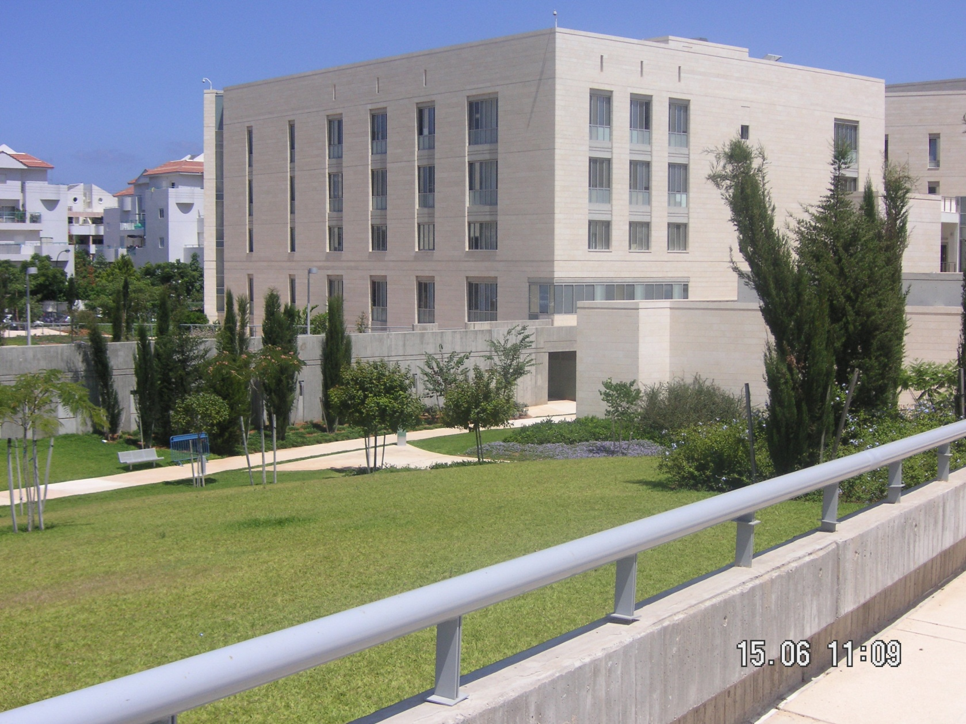
The Open University of Israel
Raanana – 15 km north of Tel Aviv

Slide 3
Presentation plan
The Use of Personal Technologies in the Classroom (study 1)
Assistive technology and support in higher education (study 2)
Goals of the studies
Results
Conclusions

Slide 4
Study 1: The Use of Personal Technologies in the Classroom: Canadian and Israeli Perspectives
For many students access to their personal technologies, as smartphones or tablets, is essential to ensure their full inclusion in the classroom.
Research shows that students, in general, like courses where they are allowed to use their personal technologies in class.
Research has also shown that multi-tasking in class is associated with poorer grades and that open devices can distract students nearby.
Numerous professors are prohibiting the use of such technologies, even though digital literacy is often an expected graduation outcome.

Slide 5
Using technology in the class:
Academic purposes and non-academic purposes
Completing quizzes
Google Docs
Google translate
Power Point
Google Search
Recording lecturers
Taking notes, pictures
Sending emails
Social networks (Facebook, twitter, whats-up etc.)

Slide 6
The Research Questions
What kind of personal technologies students and professors use their in the classroom?
Why do some professors prohibit the use of personal technologies in the classroom?

Slide 7
The research
The research involved two focus groups consisting of 8 -10 participants per group: students and professors, in each country.
The focus groups consisted of social science students who had already completed at least one term and who were currently registered in a variety of courses with a number of different professors.
The professors, like the students, were all from social science disciplines, each one representing a different content area such as psychology, business administration and education etc.

Slide 8
1. What kind of personal technologies students use their in the classroom? On-task in class activities | CAN: Students Professors | ISR: Students Professors
Use of Google: Docs for group work to look up concepts related to course material for translation | 37.5% 25% | 37.5% 25%
Cellphone: to look up conjugations of verbs To follow along with the PPT To recode the lecture (Israel 50%) To take pictures that the teacher draws in class Access dictionaries To take pictures of PPT slides | 137.5% 50% | 112.5% 150%
Laptop: for note-taking Using PowerPoint | 37.5% 25% | 25% 50%
Notes:
* Percentages are of no. of activities – more than 100%. They could choose several activities

Slide 9
1. What kind of personal technologies students use their in the classroom? On-task in class activities | CAN: Students Professors | ISR: Students Professors
Use of Google: Docs for group work to look up concepts related to course material for translation | 37.5% 25% | 37.5% 25%
Cellphone: to look up conjugations of verbs To follow along with the PPT To recode the lecture (Israel 50%) To take pictures that the teacher draws in class Access dictionaries To take pictures of PPT slides | 137.5% 50% | 112.5% 150%
Laptop: for note-taking Using PowerPoint | 37.5% 25% | 25% 50%

Slide 10
1. What kind of personal technologies students use their in the classroom? On-task in class activities | CAN: Students Professors | ISR: Students Professors
Use of Google: Docs for group work to look up concepts related to course material for translation | 37.5% 25% | 37.5% 25%
Cellphone: to look up conjugations of verbs To follow along with the PPT To recode the lecture (Israel 50%) To take pictures that the teacher draws in class Access dictionaries To take pictures of PPT slides | 137.5% 50% | 112.5% 150%
Laptop: for note-taking Using PowerPoint | 37.5% 25% | 25% 50%

Slide 11
1. What kind of personal technologies students use their in the classroom? On-task in class activities | CAN: Students Professors | ISR: Students Professors
Use of Google: Docs for group work to look up concepts related to course material for translation | 37.5% 25% | 37.5% 25%
Cellphone: to look up conjugations of verbs To follow along with the PPT To recode the lecture (Israel 50%) To take pictures that the teacher draws in class Access dictionaries To take pictures of PPT slides | 137.5% 50% | 112.5% 150%
Laptop: for note-taking Using PowerPoint | 37.5% 25% | 25% 50%

Slide 12
1. What kind of personal technologies students use their in the classroom? On-task in class activities | CAN: Students Professors | ISR: Students Professors
Use of Google: Docs for group work to look up concepts related to course material for translation | 37.5% 25% | 37.5% 25%
Cellphone: to look up conjugations of verbs To follow along with the PPT To recode the lecture (Israel 50%) To take pictures that the teacher draws in class Access dictionaries To take pictures of PPT slides | 137.5% 50% | 112.5% 150%
Laptop: for note-taking Using PowerPoint | 37.5% 25% | 25% 50%

Slide 13
1. What kind of personal technologies students use their in the classroom? On-task in class activities | CAN: Students Professors | ISR: Students Professors
Use of Google: Docs for group work to look up concepts related to course material for translation | 37.5% 25% | 37.5% 25%
Cellphone: to look up conjugations of verbs To follow along with the PPT To recode the lecture (Israel 50%) To take pictures that the teacher draws in class Access dictionaries To take pictures of PPT slides | 137.5% 50% | 112.5% 150%
Laptop: for note-taking Using PowerPoint | 37.5% 25% | 25% 50%

Slide 14
Off-task in class activities | CAN: Students Professors | ISR: Students Professors
Use cellphone/iPad: to check Instagram Snapchat Facebook e-mails WhatsApp computer games Watching videos music | 87.5% 100% | 175% 112.5%
do homework learning management system ‘To do list’ | 62.5% 50% | 25% 25%

Slide 15
Off-task in class activities | CAN: Students Professors | ISR: Students Professors
Use cellphone/iPad: to check Instagram Snapchat Facebook e-mails WhatsApp computer games Watching videos music | 87.5% 100% | 175% 112.5%
do homework learning management system ‘To do list’ | 62.5% 50% | 25% 25%

Slide 16
Off-task in class activities | CAN: Students Professors | ISR: Students Professors
Use cellphone/iPad: to check Instagram Snapchat Facebook e-mails WhatsApp computer games Watching videos music | 87.5% 100% | 175% 112.5%
do homework learning management system ‘To do list’ | 62.5% 50% | 25% 25%

Slide 17
Off-task in class activities | CAN: Students Professors | ISR: Students Professors
Use cellphone/iPad: to check Instagram Snapchat Facebook e-mails WhatsApp computer games Watching videos music | 87.5% 100% | 175% 112.5%
do homework learning management system ‘To do list’ | 62.5% 50% | 25% 25%

Slide 18
Off-task in class activities | CAN: Students Professors | ISR: Students Professors
Use cellphone/iPad: to check Instagram Snapchat Facebook e-mails WhatsApp computer games Watching videos music | 87.5% 100% | 175% 112.5%
do homework learning management system ‘To do list’ | 62.5% 50% | 25% 25%

Slide 19
2. Why do some professors prohibit the use of personal technologies in the classroom?
Students aren’t paying attention
Do not allow students to use laptop for note-taking because of potential distraction
When students are using their mobile technology in class and not paying attention to the teacher…
Checking on the cellphone…miss that material being discussed in class
Perceived phones as distraction for themselves (teacher) and the students
Checking if they had received a text message, which would be a distraction for the students
Having phones put away student and teacher focus
Flashing light that automatically starts on cellphones when you receive a text message may be distracting
Prohibiting use of cellphone in class helps students focus
Teachers prohibiting use of cellphones helps improve the focus of students in class
Cellphones are perceived as a distraction by teachers
Cellphones are prohibited to prevent distractions in class
Laptop is NOT a distraction as it is often perceived by teachers
Want students to be able to focus better in class
Use of mobile technology in class associated with students paying less attention in class
Mobile technologies “magnets” because they attract attention, even from the surrounding students

Slide 20
Teacher do not want students’ cellphones to distract students around them
Thinks that mobile technologies are a distraction
When students use social media they are more likely to ‘zone out’ and lose focus
Students may not be able to handle the distraction
Distract both the teacher and the students
If teacher distracted may not give the best quality lecture
Teacher may be worried that students are not paying attention
Students are distracted and therefore not learning
Use of cellphones in class is a distraction for the students
Notification of text is distracting for the teacher and the students
Can be distracting for other students (those sitting near them)
Students who do not need their cellphones in class can get very distracted by them
When students distract other students with their use in class this is problematic
Potential distractions e.g. asking to charge their phones in class, alarm going off
Cellphones just the new enemy…distracted in class
Distraction for professors and for the other students in Israel and in Canada

Slide 21
Professors’ Comments regarding cellphones:
Academic Success:
Students who use mobile technology in class will get lower grades
Prohibiting use of mobile technology improves student performance
Students get better grades when they are not multi-tasking
Participation:
Professors want to encourage students’ participation, to facilitate discussion, to improve students’ interaction in class
Students in classes are more engaging without cellphones,
Cellphones create a barrier between the students and the teacher

Slide 22
Professors’ Comments about Students with Disabilities
The teacher does not allow the use of cellphones or laptops in class, unless the student has an accommodation from the Accessibility Center.
Students with disabilities tend to be more vocal about how they take notes
Students with disabilities use their cellphones as a tool to help with their studies in class, but even students with disabilities are checking text messages and texting once in a while
Students with disabilities are less likely to check their text messages in class
Students use their cellphones as a glossary or dictionary in class, especially when they have a learning disability
Students with Autism Spectrum Disorder use their cellphone to text their parents if they are anxious in class or simply want to contact someone for support
Their mobile technologies help increase their awareness.

Slide 23
Students’ comments on professors and technology usage:
Professors do not understand students need to have access to mobile technology in class
Professors don’t understand how mobile technologies can help students in class
Professors hates technology
Some professors are ‘old school’
Some professors assume students are not on task
Can annoy the professors
> Lack of understanding
Technology helps student presenting and to feel more at ease.

Slide 24
A student with multiple disabilities:
How has technology changed the way you study and learn?
Technology gives me the ability to study, to progress, to success, to express myself and to utilize my potential. Without technology I couldn’t achieve my assignments through the courses I completed so far, and frankly, maybe I couldn’t even be a university student.
In high school I took the lowest class of math, and not because I was terrible in math or just lazy. The main reason was that I couldn’t write math by hand or type it on the computer, and it’s quite impossible to study math if you can’t practice it.
A few years later, I am a student of economics, with a pair of math courses in my record.
What made it possible?
Technology.

Slide 25
What technologies do you find especially useful? Why? How do you use it (e.g., in class, for studying, for exams)?
Softwares that allow me to type math symbols, complicated formulas, draw graphs and more, in a simple and easy way, without the need to have a degree in computer science.
Personally, I work with MathType and Office 365, which are great but require some creativity in order to be a powerful studying tool.
In class, video lessons, in which every student can participate from home, or watch the recorded lesson later, how many times as desired.
Video lessons turn the disability into an ability – the ability to success.

Slide 26
Findings
The findings provide an increased understanding of the needs of students for using personal technologies in class
An increased understanding of the concerns of professors and students (with and without disabilities) about the use of personal technologies in class.
Similar comments of students and professors in Israel and in Canada.

Slide 27
Study 2: to examine the
Effective use of assistive technologies in higher education for students with disabilities
1. An increasing number of studies have shown that integrating information and communication technologies (ICTs) and assistive technologies in academic studies might be effective and constructive for students with and without various disabilities.
For example, technologies that can support writing, spelling, planning, organizing, editing and calculation.

Slide 28
2. There is an increasing number of students with disabilities attending higher education.
Studies reveal that students with disabilities face various difficulties coping with necessary academic skills and/or with learning strategies compared to students without disabilities.
Assistive technology can provide students adaptive ways to compensate for deficits and enable them to improve their academic skills.

Slide 29
Obstacles at the higher education
Students with disabilities need to adapt and to adjust to the demands of higher education
To learn to deal with lack of appropriate academic skills
Need suitable academic strategies (e.g., to organize their time in order to meet the academic deadlines, summarize a text).

Slide 30
N

Slide 31
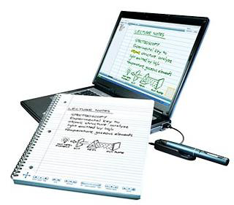
What does Assistive Technology mean?
The term ‘assistive technology device’ means any item, piece of equipment, or product system (whether acquired off the shelf, modified, or customized) that is used to increase, maintain or improve the functional capability of an individual with disability.
Assistive technology service means any service that directly assists a child with a disability in the selection, acquisition, or use of an assistive technology device.

Slide 32
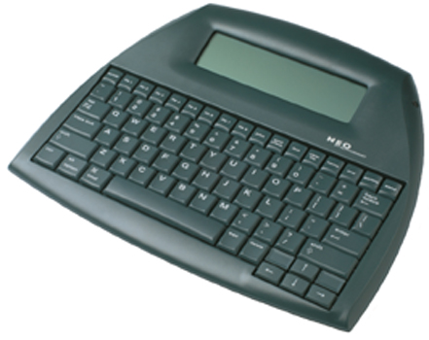

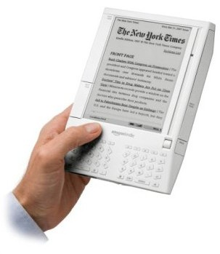
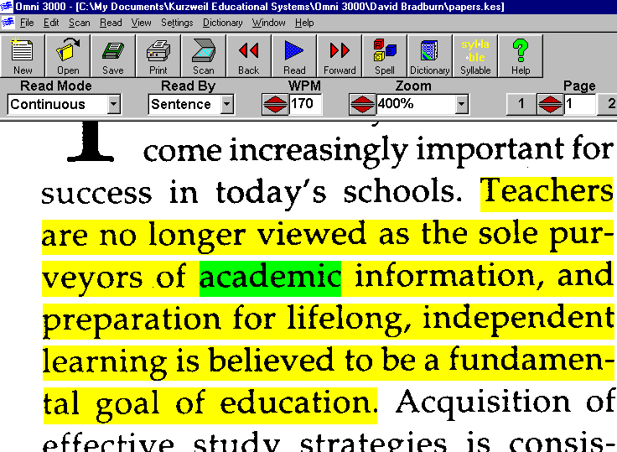
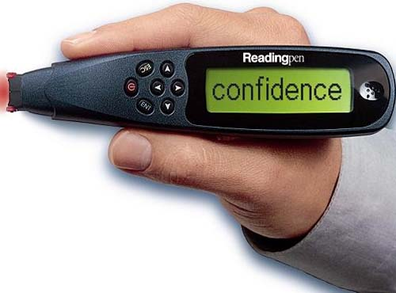
What Kinds of Assistive Technology Tools are Available?
Reading and Scanning Software
Notes:
Audio books
Text To Speech Software
Optical character recognition
Talking spell-checkers and electronic dictionaries

Slide 33
Accessibility Tools at the OUI
The varieties of AT tools used by tutors at the OUI can be divided into six types:
Online course materials (e.g., web-links and course notes)
Online tools (e.g., collaborative work online and videos)
Hardware (e.g., projector and SMART board)
Communication tools (e.g., chat room and email)
Social networking (e.g., blogs, Facebook, Twitter)
Computer technologies used in class (e.g., simulations and presentation software- grammar/ spelling checkers, dictionaries, and English Text-To-Speech (TTS) Software)

Slide 34
Obstacles at the higher education for students with disabilities
Academic Difficulties
Reading
Writing
Listening
Speaking
Quantitative ability
Reasoning
Social Difficulties
Deficiencies in social skills
Difficulties to interpret what they see and hear
At risk for social isolation, or rejection
Emotional Difficulties
Lower perceptions of their competence
Lower self-esteem
Lack of self–confidence
Stress
Need more support
Behavioral Difficulties
Adjusting to change
Lower adaptability
Difficulties with criticism
Difficulties in handling pressure

Slide 35
AT for students with disabilities
Reading
OCR/Speech Synthesis
Speech Synthesis
Alternative format books (e.g., tape, CD)
Writing
Word Processor
Word Prediction
Speech Synthesis
Speech Recognition
Graphic Organizer
Spell Checker
Math
Talking Calculator
Electronic Worksheets
Organization
Personal Data Manager
Tape Recorder
Free-form Database
Listening
Assistive Listening Device
Tape Recorder

Slide 36
The ICTs accommodations that are needed for students with disabilities

Slide 37
The advantages of using ICTs for students with disabilities

Slide 38
The disadvantages of using ICTs for students with disabilities

Slide 39
Conclusions
Canada and Israel
The most popular ICT's were: software for editing; correction and text to speech
Computers or laptops are essential for students with disabilities;
There is need to increase the accessibility of ICT;
Similar benefits.
Canada
The main disadvantages were of the assistive technology and ICTs:
  high costs
  technical problems
  extra effort and time due to the use of ICT
Israel
The main disadvantages were:
  lack of ICT that support the Hebrew language
  lack of training
  difficulty of obtaining services

Slide 40
Conclusions and Implications
The most frequently mentioned software is in the area of Writing and correction software - grammar/ spelling checkers, dictionaries, and English Text-To-Speech (TTS) Software.
Success in academic area is the essential perceived advantage to using ICTs.
Lack of technologies which support the Hebrew language compared to the variety of ICTs in English.
A need to increase the quality of the Hebrew Voice relate to TTS software.
Lack of training, information and difficulty obtaining services are the major disadvantage to using ICTs.
A need to improve the accessibility for ICTs resources.

Slide 41
There are still a few problems for implementing ICTs
Lack of technologies which support Hebrew language compared to the variety of ICT in English.
A need to increase the quality of the Hebrew Voice related to TTS software.
Lack of training, information and difficulty obtaining services.
A need to improve the accessibility for ICT resources.
Budget - the process of physical accessibility is complicated because many students study in different OUI centers all over the country.
Assistive technologies and ICT support are very expensive.
Disagreements among students without disabilities (slow studying; achievements; conflicts of interests regarding the different needs).

Slide 42
Thanks to:
Canadian team: Laura King, Catherine Fichten, Mary Jorgensen, Alice Havel
Laura King, M.A.: Research Associate, Adaptech Research Network, Montréal Canada, 1-514-364-3320 ext. 6718, laura.king@claurendeau.qc.ca
Catherine Fichten, Ph.D.: Professor of psychology, Dawson College, Professor of psychiatry, McGill University, Psychologist, Jewish General Hospital, Co-Director, Adaptech Research Network, Montréal Canada, 1-514-931-8731 ext. 1546, catherine.fichten@mcgill.ca
Mary Jorgensen, B.A.: Research Associate, Adaptech Research Network, Montréal Canada, 1-514-931-8731 ext. 3586, MJORGENSEN07@ubishops.ca
Alice Havel, Ph.D.: Former co-coordinator of Dawson College’s Access Ability Center, Dawson College, Research Associate, Adaptech Research Network, Montréal Canada, 1-541-931-8731 ext. 3584, ahavel@dawsoncollege.qc.ca
Israeli team: Tali Heiman, Dorit Olenik-Shemesh, Dana Kaspi-Tsahor
Tali Heiman, Ph.D.: Professor of special education, Department of Education and Psychology, The Open University of Israel, 972-544478050, talihe@openu.ac.il
Dorit Olenik-Shemesh, Ph.D.: Researcher, Senior Lecturer, Department of Psychology and Education, The Open University of Israel. 972-544-508787. doritol@openu.ac.il
Dana Kaspi-Tsahor, Ph.D. student: Lecturer and coordinator, Department of Psychology and Education; Former Head of Accessibility Section, Dean of Student, The Open University of Israel. Authorized Service Accessibility Expert. 972-509-412058, danakas@openu.ac.il

