Slide 1



Emerging Technologies for Students with Disabilities: Information for Faculty
Fichten, C., & Havel, A. (2023, January 10-11). Enabling technologies for students with disabilities: Information for faculty [Invited speakers]. Intercollegiate Pedagocical Day, Montreal, QC, Canada.
Catherine Fichten and Alice Havel
Dawson College and the Adaptech Research Network
Intercollegiate Pedagogical Day
January 10-11, 2023
https://vimeo.com/channels/1518882/787594072

Slide 2
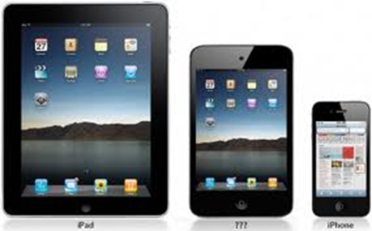
Objectives
Awareness of assistive technologies used by
  Students with disabilities
  Other students
Importance of allowing students to access their tech

Slide 3

Who Are We?
The Adaptech Research Network
  Team: faculty, students, researchers, service providers
  Research on post-secondary students with & without disabilities
  Focus on technologies
  Based at Dawson College

Slide 4
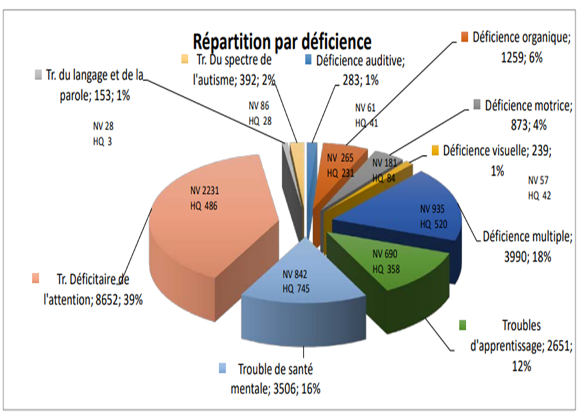
Who are the Students with Disabilities in 2023?
  Self-reported disability: 11%-25% of students
  Students with “non-apparent” disabilities
      Attention deficit hyperactivity disorder (39%)
      Mental health-related disabilities (16%)
      Learning disabilities (12%)
      Chronic health conditions (6%)

Slide 5

Who are the Students with Disabilities in 2023?
  ≈ 50% have multiple disabilities
  ≈ 2/3 not registered with campus access services

Slide 6
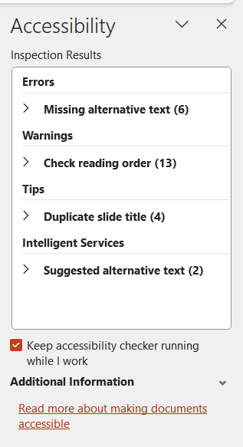
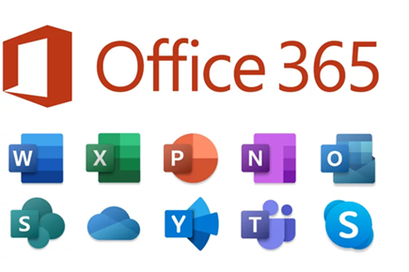
Impact & Evolution of the Accessibility of General Use Technologies
Built-in accessibility features
  Harness potential of general use tech as assistive tech for all
  Office 365
    Magnification
    Accessibility checker/corrector
      Type accessibility checker into the search bar

Slide 7
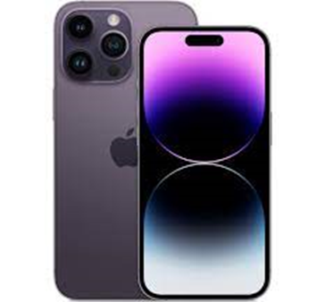
Impact & Evolution of the Accessibility of General Use Technologies
Built-in accessibility features
  Adobe Acrobat Pro
    Convert document to Word
    Accessibility checker tool
    OCR
Proliferation of audiobooks, EPUB
Mobile technologies

Slide 8


Increasing Use of Artificial Intelligence (AI) in General Use Technologies
Video captioning (craptions)
  Zoom
  TEAMS
Office 365
  Text-to-speech (dictation)
  Word prediction
Voice search for Google search engine

Slide 9
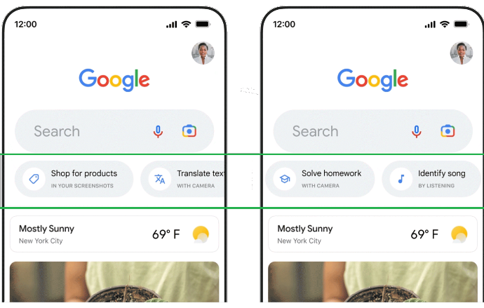
Increasing Use of Artificial Intelligence (AI) in General Use Technologies
Google app on iPhone
  “Search inside photo”
  “Solve homework”
  “Identify song”
  “Translate text”
Control of mobile device using voice commands
  Siri
  Google Assist

Slide 10
Continuing Barriers
Digital ≠ accessible
  Use accessibility checker
Tech incompatible with students’ assistive technologies
  Problems for STEM
    Data analysis software
    Peer reviewed journal databases
Certain content difficult to access through audio

Slide 11
Continuing Barriers
Some assistive tech still expensive
Design of academic evaluations can create barriers
Inaccessible documents & coursepacks produced by faculty
  If document is not “clean” it cannot be scanned and OCRd
French language software often not up-to-date

Slide 12
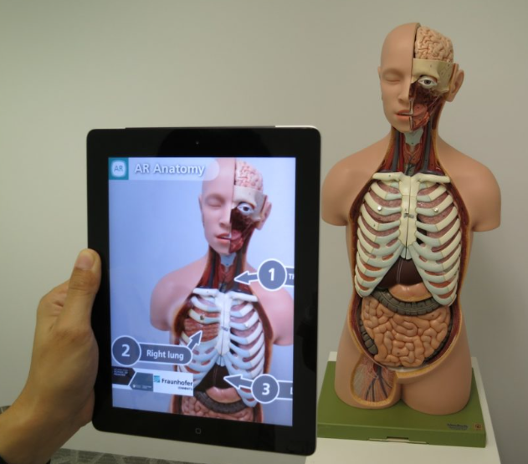
Interesting Upcoming Tech
Telecollaboration (e.g., remote access to real-world field trips)
Virtual and augmented reality
  Development of chemistry labs
Smart gloves
Indoor navigation
Smart glasses
  Cameras, headphones, heads-up, text, sign language displays
Potential of robots in STEM

Slide 13


In Summary
  Many beneficial tech related changes
  Many barriers remain
  The future is exciting!
Adaptech Research Network: www.adaptech.org
Catherine Fichten: cfichten@dawsoncollege.qc.ca
Alice Havel: ahavel@dawsoncollege.qc.ca

