Slide 1
From Sleep to Student Success: Navigating the Research Obstacle Course
Catherine Fichten and Two Huge Invisible Teams
Dawson/Adaptech Team
Jillian Budd, Alice Havel, Mary Jorgensen, Laura King, Evelyne Marcil, Mai N. Nguyen, Cristina Vitouchanskaia +++
Jewish General Hospital Team
Sally Bailes, Laura Creti, Eva Libman, Dorrie Rizzo +++
Celebrate Research: Research Symposium, Dawson College, Montreal, May, 2015

Slide 2
Jewish General Hospital
Where it all started – early 1980s
College people ineligible for grant funding
Hospital had grant on sexuality
Funded by what is now called FRQSC
Eva Libman was principal investigator
I was a tag-along

Slide 3
Jewish General Hospital
2015 – we’re still in the bedroom
Grants related to sleep, insomnia, obstructive sleep apnea
Funded by CIHR and FRQS
Eva Libman still principal investigator
I am a co-investigator
Laura Creti, also a co-investigator
My student - and first research assistant at Dawson

Slide 4
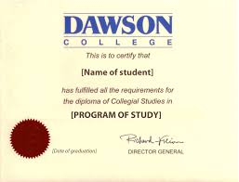
Dawson College
Mid - 1980s on
Started with disability and prejudice
Evolved into Adaptech Research Network
Disability, tech, student success
Many Dawson people
Alice Havel, Shirley Jorgensen, Susie Wileman,
Rafael Scapin, Rajesh Malik
Many of my former students
Maria Barile, Jennison Asuncion, Jillian Budd, Natalie Martiniello, Rosie Arcuri, Crystal James, Gabrielle Lesage, Jennifer Gutberg…

Slide 5
Dawson College
Key accomplishments
Bilingual free and inexpensive technology database
For students with disabilities
Web site = adaptech.org/en/downloads

Slide 6
Dawson College – 5 Key Findings
Students with and without disabilities graduate at the same rate…
Take more time
Students with LD don't use assistive technologies recommended by experts
Giving students with LD and nondisabled adequate & poor readers extended time
Comparable reading comprehension

Slide 7
Dawson College – 5 Key Findings
Students registered for access services
More likely to intend to graduate
Employment
Main concern of students with disabilities
Grads with disabilities ≈ 70%
Grads without disabilities > 90%

Slide 8
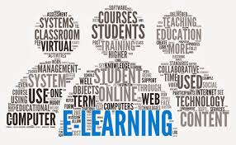
Dawson College – Ongoing Research
E-learning used in Cegep teaching
Student views
Technologies used by their teachers
Technologies that worked well for them
Named 3 teachers who use tech in excellent ways
Teacher views
Ongoing interviews

Slide 9
More Information
Adaptech Research Network
www.adaptech.org

