Slide 1
Browser Extensions For All
Rosie Arcuri, Christine Vo, Catherine Fichten, Mary Jorgensen, Maegan Harvison, and Abi Vasseur
Adaptech Research Network
Student Panel about Disability Issues
AQEIPS / NEADS Webinar
November 12, 2021

Slide 2
Agenda
PowerPoint presentation
What are chrome extensions
How do you download chrome extensions safely
Chrome extensions for reading, writing, note taking, productivity, alternative mice/ keyboards
An alternative for AT
Video/Demonstration
Questions

Slide 3
Introduction
Google Chrome is the most popular browser in Canada (Lui 2021)
Most students with disabilities, especially those with ADHD, mental health and LD chose not to use AT’s
Cost
Fear of being singled out
Lack of training

Slide 4
This Initiative
180 relevant extensions compiled
100 extensions deemed safe
Updated in 2019 or later
50 extensions tested
Unique function
Popularity
Customer reviews

Slide 5
What is an extension?
Programs that change the browser experience by:
Adding a function:
Display: background color, text size, remove adds and distractions
Website and tab navigation: use the keyboard or mouse to alter navigation

Slide 6
What is an Extension? (2)
Linking to external services
Spell and grammar checkers
Productivity and organizational tools
Text-to-speech and other reading tools

Slide 7
How to install an extension (Source: Chrome Webstore)
Sign into your Chrome (Gmail login)
Open the Chrome Web Store.
Search for an extension
Click Add to Chrome.
If prompted,, click Add extension

Slide 8
Safety Tips (1)
Is this extension from a developer that is a trusted source?
Is the developer's website consistent with the information on extension page on the Google Chrome store
Are the extension's permission requests consistent with the features of the extension?
Source: Assessing Safety Extension

Slide 9
Safety Tips (2)
Does the extension's description or website explain why they need those permissions?
Does the extension have a privacy policy, and am I comfortable with how the data is being used under the privacy policy?
Source: Assessing Safety Extension

Slide 10
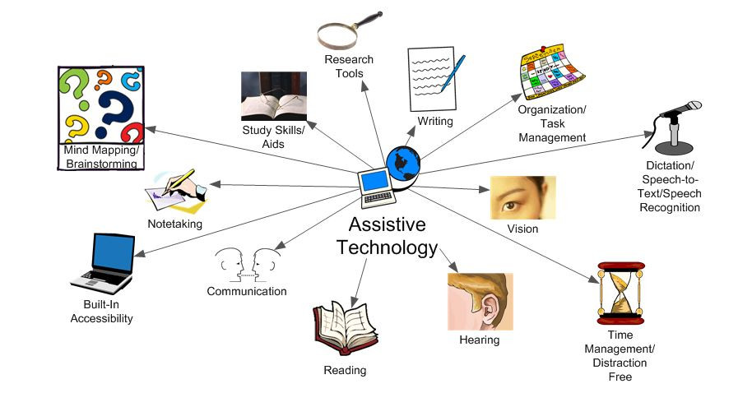
AT vs Extensions - AT
Often expensive
Students avoid due to fear of stigma
Comprehensive tools can be overwhelming to learn
Designed for specific needs
More training available

Slide 11
AT vs Extensions - Extensions
Extensions
Often free or inexpensive
Used by the general public
Simple or complex
May require many extensions to replace comprehensive AT program
Information not always available
Minimal training

Slide 12
Pro’s of using Extensions
Extensions can be alternatives for AT for students
Hesitant to use AT due to fear of stigma
Do not have AT funding or training
Need minimal support
Have some tech experience
Are not afraid to try and test options

Slide 13
Cons of using Extensions
Extensions may not be alternatives for AT if students
Already use a tool they find works well
Want to learn only one tool
Have complex or specialized needs
Need 1:1 training
Are anxious about using tech
Are using a screen reader or voice recognition

Slide 14
Thank You!
Adaptech Research Network: www.adaptech.org
Rosie Arcuri: rosie.arcuri@mail.mcgill.ca

