Slide 1
2015 Joint Congress on Medical Imaging and Radiation Science Clinical Integration of Students with Learning Disabilities
Alice Havel, Ph.D. Susie Wileman, M.Ed.
Former Coordinator, Coordinator, Student AccessAbility Centre
Student AccessAbility Centre, Dawson College
Dawson College Research Associate, CRISPESH
Research Associate,
Adaptech Research Network

Slide 2
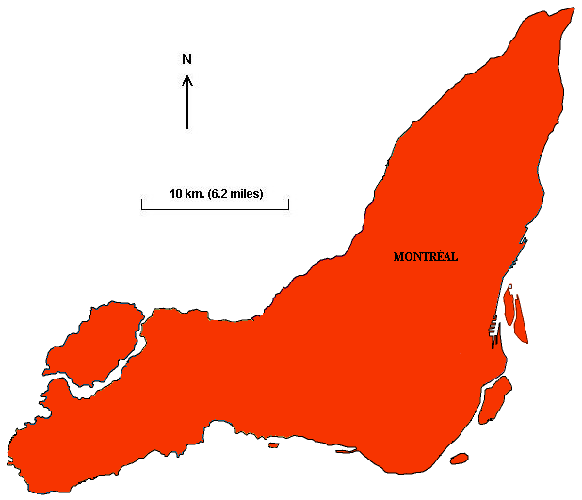
Where are we?
You are here

Slide 3
Why are we here?
Inclusion
Human Rights / legislation
Social responsibility
Under-exploited resource

Slide 4
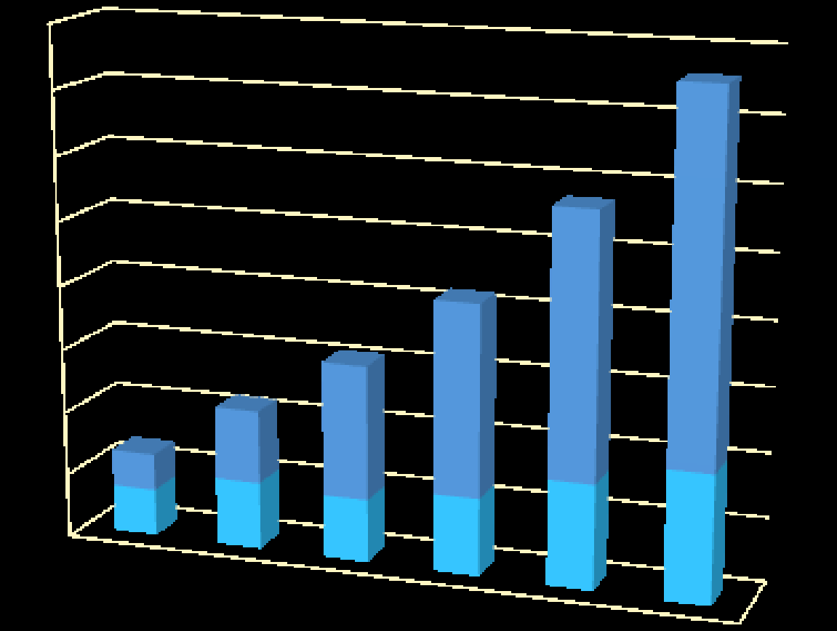
Why now?
Evolution of students with disabilities in the post- secondary
in Quebec 2007-2013 (Comité interordres, 2013)
8000
7000
6000
5000
4000
3000
2000
1000
0
AD(H)D,
Mental Health,
LD, ASD
Sensory,
motor or
neurological
impairments
2007-08 2008-09 2009-10 2010-11 2011-12 2012-13

Slide 5
As service providers and educators we’re concerned about the:
Consumers of health / medical services (including us)!
Professional Associations (certification)
Employment sector
Academic integrity of our institutions
Students

Slide 6
Learning Disabilities (LD) Diverse group of disorders May include difficulties with underlying cognitive processes
Visual processing
Auditory processing
Speed of processing
Perceptual and quantitative reasoning
Expressive and receptive language
Executive functioning

Slide 7
i.o.w. Learning Disabilities
Effect the way in which an individual takes in, sorts, retrieves and expresses information
Neurologically based
Intrinsic to the individual
Don’t go away over time
Compensated by strategies

Slide 8
Learning Disabilities can look like…
Lower intelligence
Lack of motivation
Anxiety
Fatigue (due to cognitive effort)

Slide 9
However, students with LD
By definition, have average to above average intelligence
Brinkerhoff & Banerjee (2011)
Frequently good problem-solvers
Generally motivated
Can be gifted (e.g. Major Award Winners)

Slide 10
In other words…
This is the new ‘normal’
…along with ADHD, Autism Spectrum Disorders and Mental Health Disorders

Slide 11
How do we accommodate these students in the post-secondary milieu?
Traditionally, individually targeted accommodations, such as:
Test accommodations (e.g. extended time, distraction-free environment)
Note-takers
Use of adaptive technologies
Reduced course load
Strategic learning interventions

Slide 12
Universal Design for Learning, the New Frontier
UDL changes the learning environment
Implemented in design phase
Beneficial to all
Multiple means of
Representation
Action and Expression
Engagement

Slide 13
Teaching Strategies – UDL Focus
Express openness to diversity
Great variety among learners (rate of learning)
Variety of presentation styles
Separate the ‘how’ from the ‘what’

Slide 14
Rx: UDL, Some Strategies
Challenge
Response
Spelling
Expressive language (writing)
Receptive language (reading)
Lexicon of terms in a digital format (smart-phone)
Use of technology e.g. writing software, voice-to-text
Documents in e-format, text-to-speech software
Notes:
Next slide, we ask them to describe challenges and come up with suggestions (could break into groups).
Spelling example separates the ‘how’ from the ‘what’
If a

Slide 15
Rx: UDL, Some Clinical Strategies contd.
Challenge
Response
Auditory processing
Processing speed
Elevated anxiety
Appropriate acoustics, face-to-face communication
Gradually decrease extended time, provide materials in advance
Practice tests, metacognition, opportunities for clarification

Slide 16
Application of UDL in Your Setting
Other Challenges
Responses

Slide 17
References
Carey, B.M. et.al. (2014) Meeting the Needs of Students with Disabilities in Health-Related Education Programs. The Association of Higher Education and Disability (AHEAD)
Marks, B. (2014) White Paper on Inclusion of Students with Disabilities in Nursing Educational Programs for the California Committee on Employment of People with Disabilities (CCEPD)
CAST (Center for Applied Special Technology) www.cast.org

Slide 18
Thank-you!
Alice Havel
Consultant, Dawson College, Research Associate, Adaptech Research Network ahavel@dawsoncollege.qc.ca
Susie Wileman
Coordinator, Student AccessAbility Centre, Dawson College, Research Associate, CRISPESH swileman@dawsoncollege.qc.ca

