Slide 1



Influential Trends Related to Emerging Technologies and Digital Accessibility for
Post-Secondary Students with Disabilities
Fichten, C. (2022, December 2). Influential trends related to emerging technologies and digital accessibility for post-secondary students with disabilities [Invited speaker]. National Dialogues and Action for Inclusive Higher Education and Communities, Montreal, QC, Canada.
Catherine Fichten and Members of the
Adaptech Research Network
National Dialogues and Action for Inclusive Higher Education and Communities
December 2, 2022

Slide 2

Who Are We?
The Adaptech Research Network
  Team: faculty, students, researchers, service providers
  Research on post-secondary students with & without disabilities
  Focus on technologies
  Based at Dawson College
Goals today
  Reflect on tech changes in the past decade

Slide 3
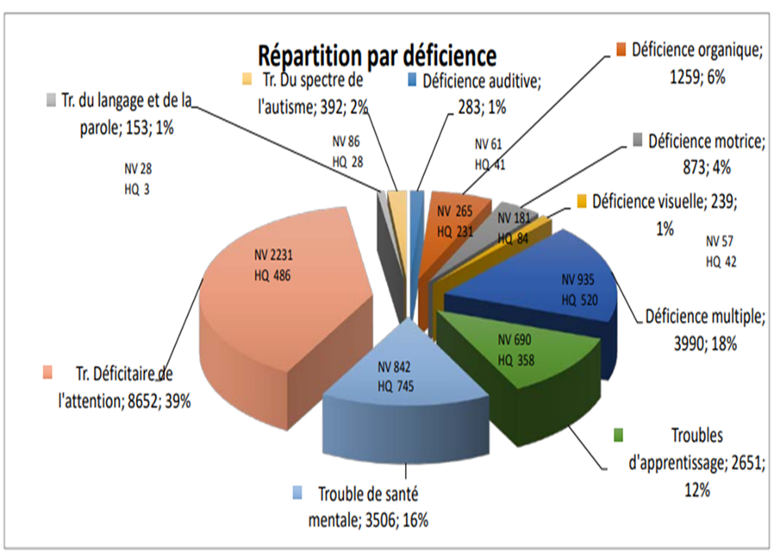
Who are the Students with Disabilities in 2022?
  Self-reported disability: 11%-25% of students
  Students with “non-visible” disabilities
      Attention deficit hyperactivity disorder 39%
      Mental health related disabilities 16%
      Learning disabilities 12%
  ≈ 2/3 not registered with campus access services

Slide 4
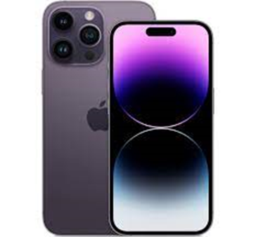
Impact & Evolution of the Accessibility of General Use Technologies
Built-in accessibility features
  Harness potential of general use tech as AT for all students
  Office 365
  Adobe Acrobat Pro
  Proliferation of audiobooks, EPUB
  Mobile technologies
Notes:
Office 365
Accessibility checker/corrector, immersive reader, magnification
Adobe Acrobat Pro
OCR, keyboard alternative to a mouse, high contrast

Slide 5
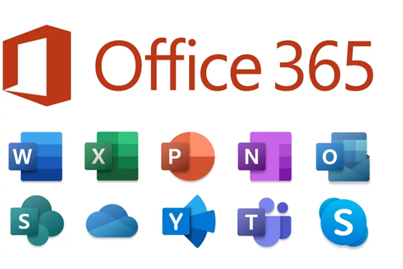

Increasing Use of Artificial Intelligence (AI) in General Use Technologies
Video captioning (craptions): Zoom, TEAMS
Office 365
Voice search for search engines
Control of computer using voice commands (e.g., Siri)
Google Lens part of Google search on smartphone
AI based psychological support apps
Notes:
Office 365
Text-to-speech, dictation, word prediction

Slide 6
Continuing Barriers
Data analysis software, peer reviewed journal databases
Certain content difficult to access through audio
Some AT software & hardware are still expensive
Design of academic evaluations can create barriers
Inaccessible documents & coursepacks produced by faculty
French language software often not up-to-date
Notes:
Digital ≠ accessible
Data analysis software, peer reviewed journal databases
Incompatible with students’ AT
Problems for STEM

Slide 7

Interesting Emerging Tech
Virtual and augmented reality, the metaverse
Telecollaboration
  Remote access to real-world field trips etc.
Smart glasses
Smart gloves
Indoor navigation
Potential of robots in STEM
Notes:
Virtual and augmented reality, the metaverse
Development of chemistry labs
Smart glasses
Cameras, headphones, & heads-up, text, sign language displays

Slide 8


In Summary
  Many beneficial tech related changes
  Many barriers remain
  The future is exciting!
Adaptech Research Network: www.adaptech.org
Catherine Fichten: catherine.fichten@mcgill.ca

