Slide 1

Fichten, C. (2023, February 8). Sleep, insomnia, ghoulies and ghosties, and things that
go bump in the night [Invited speaker]. Dawson College Social Science Week, Montreal,
QC, Canada.
Sleep, Insomnia, Ghoulies and Ghosties,
and Things that Go Bump in the Night
Catherine Fichten
Dawson College Social Science Week, February, 8, 2023
Montreal
catherine.fichten@mcgill.ca

Slide 2

Learning Objectives
• Understanding
• Sleep
• Insomnia
• Delayed/advanced sleep phase
• Nightmares
• Understanding parasomnias
• Sleepwalking
• Sleep paralysis
• Night terrors
catherine.fichten@mcgill.ca
2

Slide 3
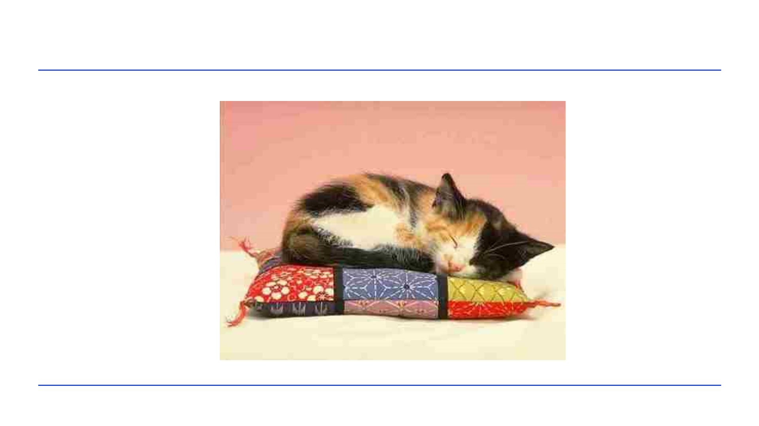
catherine.fichten@mcgill.ca
3

Slide 4
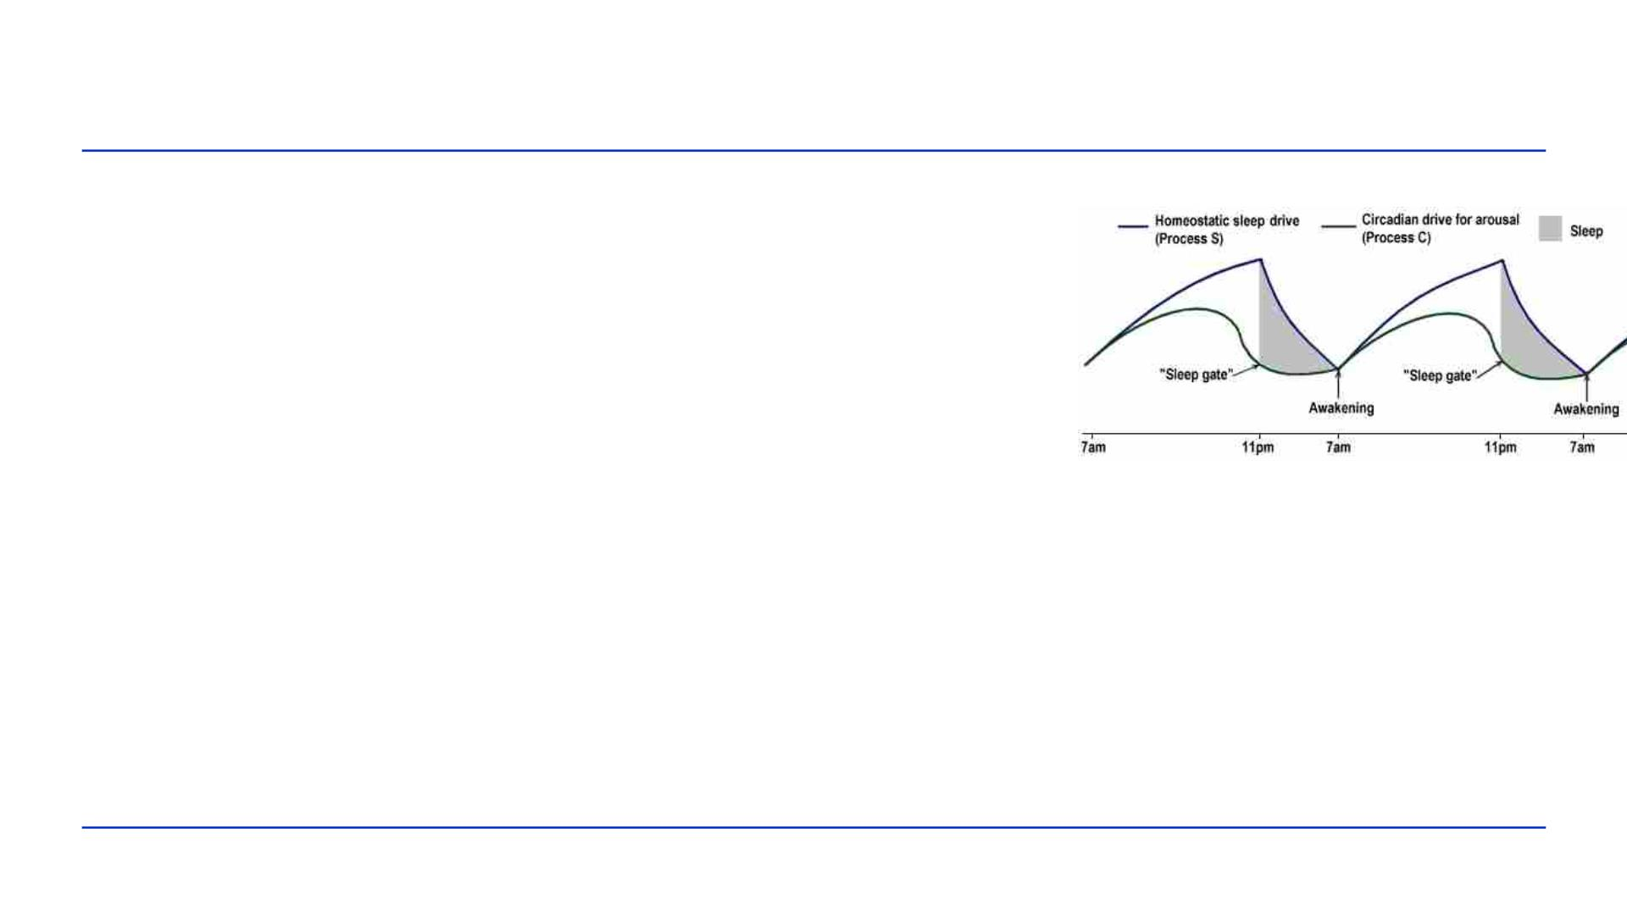
Understanding Sleep
• Regulated by 2 opposing systems
• Homeostasis (sleep drive)
• Longer time since sleep, the sleepier
• Circadian rhythm (alerting force)
• Daily behavioral and physiological cycle
• Independent of preceding sleep or wakefulness
• Coordinated with day-night / light-dark
• Melatonin, cortisol, temperature
catherine.fichten@mcgill.ca
4

Slide 5
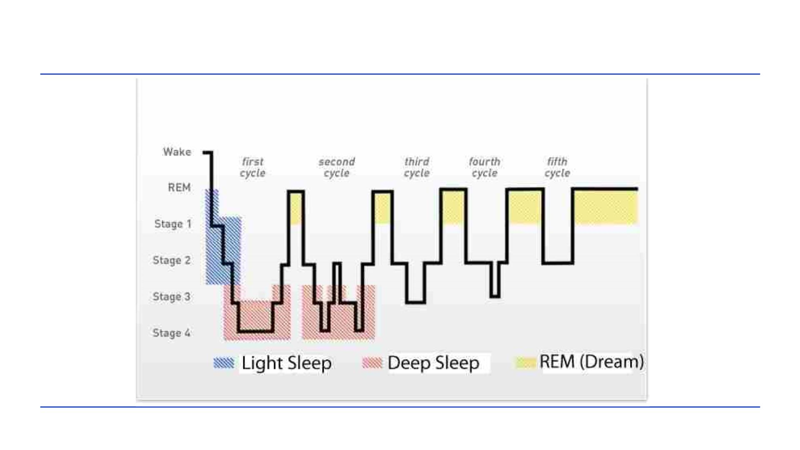
Sleep Phases
catherine.fichten@mcgill.ca
5

Slide 6
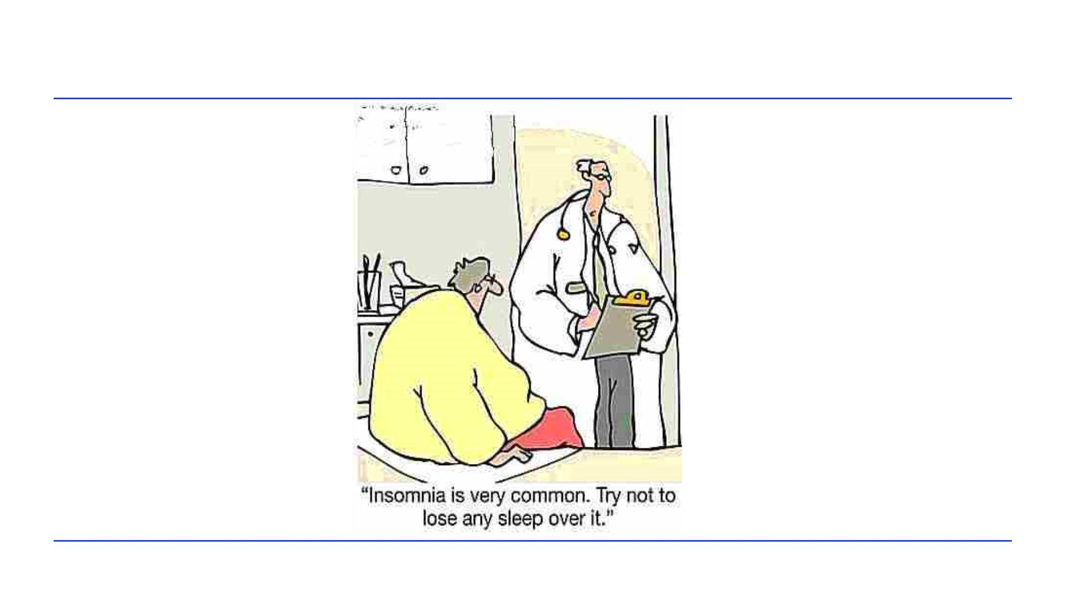
Understanding Insomnia
catherine.fichten@mcgill.ca
6

Slide 7
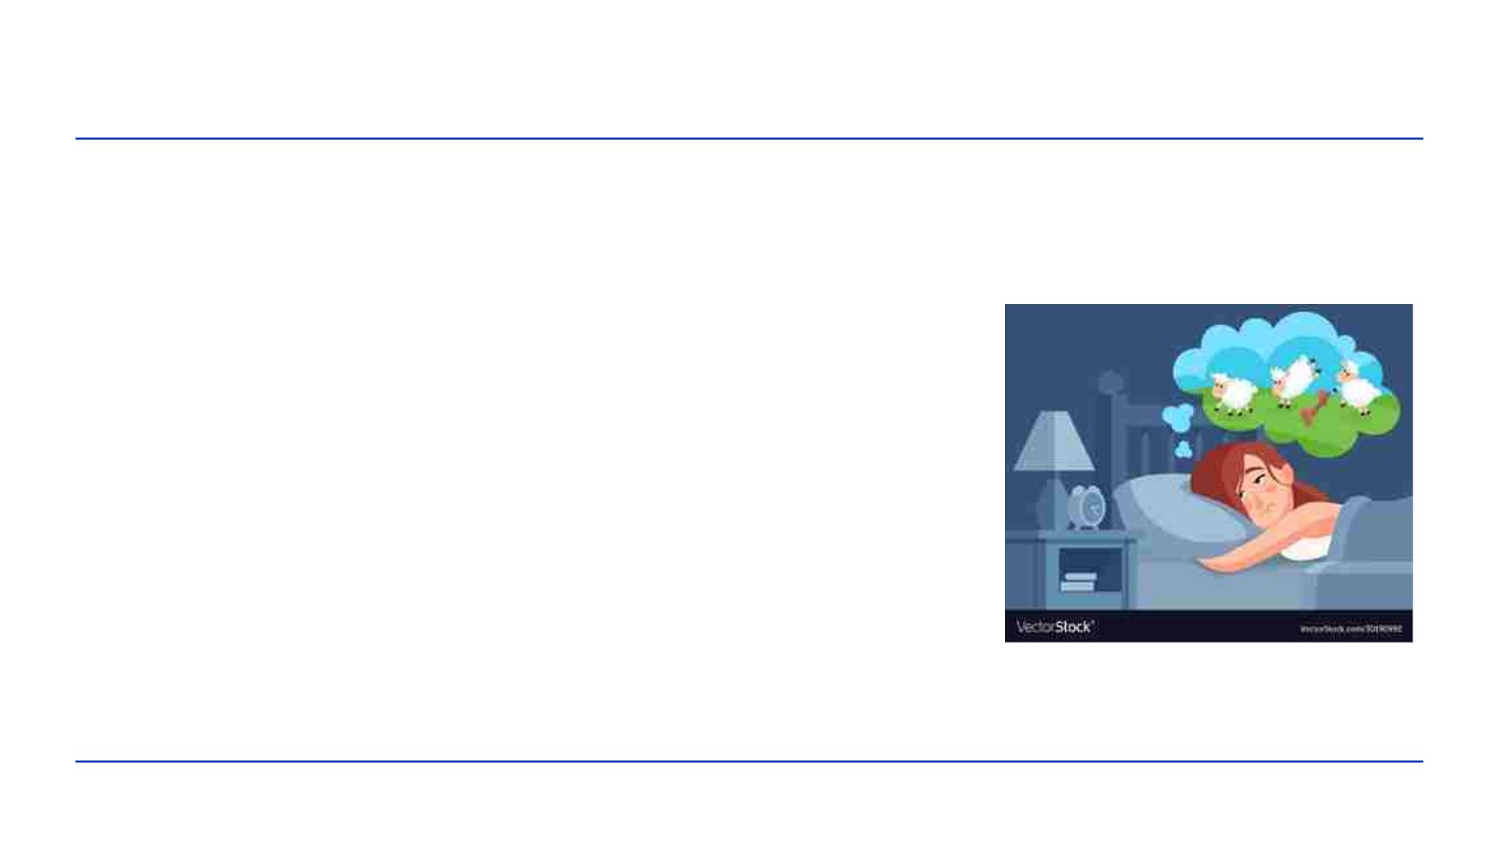
Understanding Insomnia
• Definition
• At least 31 minutes unwanted wakefulness
• At least 3 times per week
• At least 3 months
• Difficulty falling asleep (SOL)
• Difficulty staying asleep (WASO)
• Terminal insomnia
• Broken or irregular sleep
• Daytime consequences / distress
catherine.fichten@mcgill.ca
7

Slide 8
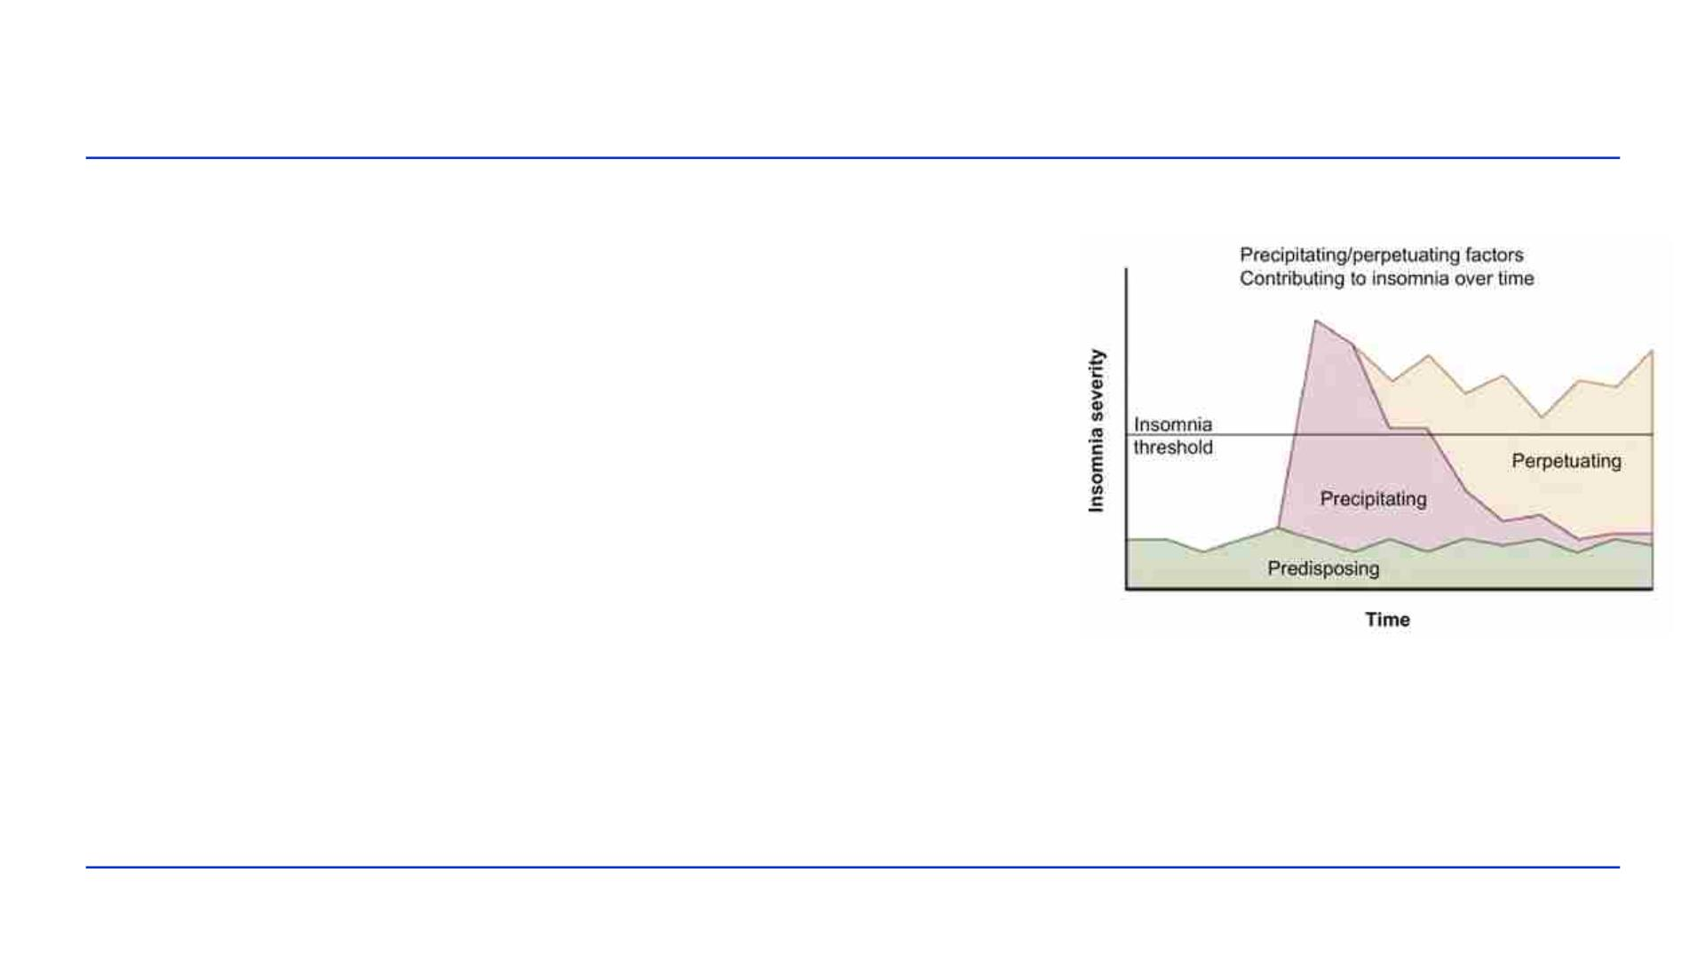
Understanding Insomnia
• Causes
• Predisposing factors
• Heredity
• Cognitive or physiological hyperarousal
• Precipitating factors
• Triggers – the “cause” of insomnia
• Perpetuating factors
• E.g., longer bedtimes, naps
catherine.fichten@mcgill.ca
8

Slide 9
Sleep Onset Insomnia
• Try the following
• Set aside “worry time”
• Maintain a “buffer period”
• Move bedtime later, keep arising constant
• Interrupt intrusive thoughts in bed
• Read, listen to verbal material, TV
• Learn to rest
• Relaxation, guided imagery
catherine.fichten@mcgill.ca
9

Slide 10
Sleep Maintenance Insomnia
• Wake after sleep onset + difficulty getting back to sleep
• Try
• Move arising time earlier, bedtime constant
• If awake and agitated in bed, get out of bed
• Go back to bed ONLY when sleepy
• If comfortable in bed
• Relaxation exercises, imagery, reading, TV
catherine.fichten@mcgill.ca
10

Slide 11

For Broken or Irregular Sleep
• Sleep restriction
• Establish average nightly SLEEP time (e.g., 6 hr.)
• Choose consistent bedtime and arising time to yield EXACTLY
this amount in bed (e.g., 6 hr.)
• Never less than 5 hr.
• Alter both bedtime and rising time
• When sleeping the allotted time for 1 week
• Add 15 min. to bedtime and repeat
• Avoid napping
catherine.fichten@mcgill.ca
11

Slide 12
For Longstanding Insomnia
• A psychologist
• Bibliotherapy
• “Goodnight mind”
• Online
• Sleepio
• Go! To Sleep Program – Cleveland
• SHUTi
catherine.fichten@mcgill.ca
12

Slide 13

Owls and Larks
• Morningness Eveningness Questionnaire
• Large hereditary component
• Larks
• Up-at-dawn
• Raring-to-go early bird
• Owls
• Enjoy staying up late
• Trouble waking up in the morning
catherine.fichten@mcgill.ca
13

Slide 14
Owls and Larks
• Readings
• “Gender differences in morningness-eveningness preference”
• “Can night owls become early birds?”
•• https://www.ncbi.nlm.nih.gov/pubmed/12182498
• https://www.theglobeandmail.com/life/can-night-owls-
become-early-birds/article26113963/
catherine.fichten@mcgill.ca
14

Slide 15
Delayed or Advanced Sleep Phase
• Problem
• Falling asleep
• Very late = delayed sleep phase (students, ADHD, autism)
• Very early = advanced sleep phase (older adults)
• Waking late (or early) – 7-8 hours later
• This is NOT insomnia
• Reading
• “Delayed Sleep Phase Syndrome - Cleveland Clinic”
https://my.clevelandclinic.org/health/diseases/14295-delayed-sleep-phase-
syndrome-dsps
catherine.fichten@mcgill.ca
15

Slide 16
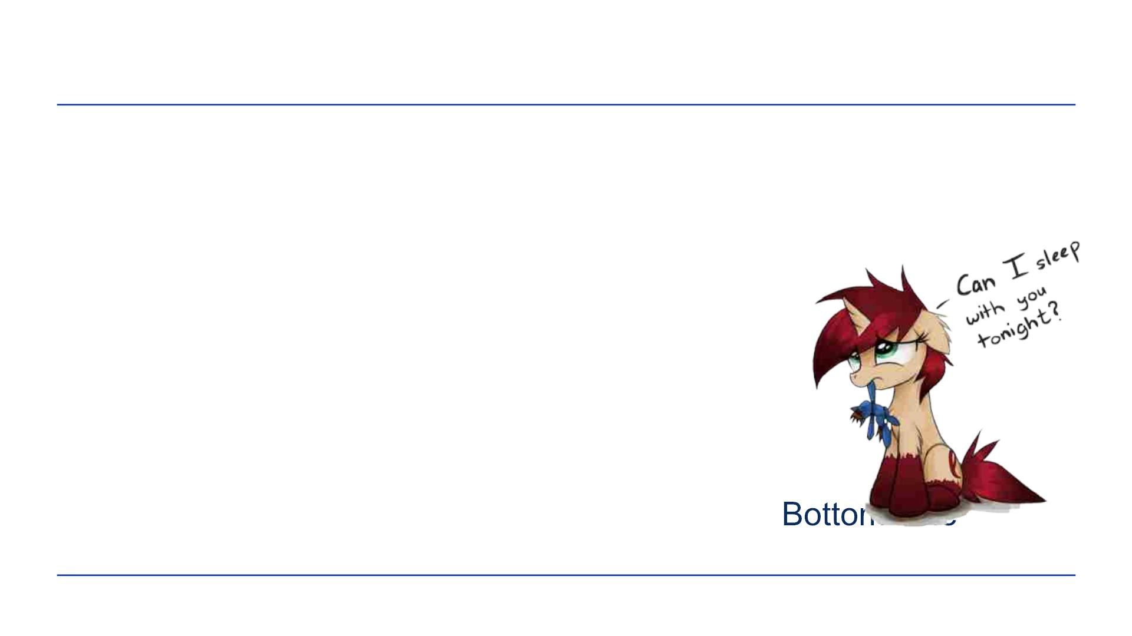
Nightmares: Imagery Rehearsal Therapy
Barry Krakow
• Choose a recent nightmare
• Unrelated to a real life traumatic event
• Replay nightmare but change story & ending
• In thoughts or in writing
• Rehearse the revised dream
• Re-write it or play again in your mind
• 5 to 10 minutes before bedtime
• Reading
• “Transform Nightmares into Sweet Dreams:
• https://bottomlineinc.com/health/sleep/transform-nightmares-sweet-dreams
catherine.fichten@mcgill.ca
16

Slide 17

Chronic Nightmares Video
catherine.fichten@mcgill.ca
17

Slide 18
Understanding Parasomnias
• Sleepwalking
• Occurs in deep sleep
• Not just walking
• Complex behaviors
• Not associated with dreams
• Can be dangerous NOT to wake person
• Reading
• “National Sleep Foundation – Sleepwalking”
https://sleepfoundation.org/sleep-disorders-problems/abnormal-sleep-
behaviors/sleepwalking
catherine.fichten@mcgill.ca
18

Slide 19
Understanding Parasomnias
• Night terrors
• Episodes of screaming, intense arousal flailing while still asleep
• Terrifying for observer
• Generally not remembered by sleeper
• Hard to wake the sleeper
• Reading
• “Sleep terrors (night terrors) – Mayo Clinic”
https://www.mayoclinic.org/diseases-conditions/sleep-terrors/symptoms-
causes/syc-20353524
19

Slide 20
Understanding Parasomnias
• Sleep paralysis +
• Hypnagogic hallucination – when falling asleep
• Hypnopompic hallucination - when waking up
• Waking & conscious but unable to move
• Feeling of choking or pressure on chest
• Incubus / succubus attack
• Lasts minutes
• Reading
• “Sleep Paralysis – WebMD”
• https://www.webmd.com/sleep-disorders/guide/sleep-paralysis#1
catherine.fichten@mcgill.ca
20

Slide 21

Questions
We are doing research on sleep patterns
and experiences. For more info or if you
are interested
• Email catherine.fichten@mcgill.ca
Dr. Catherine Fichten
Psychology Department
Dawson College
21

