Slide 1
Sleep Quality in Post-Secondary Populations with and Without Disabilities
Wing, S., & Costin, G. (2022, October 26). Sleep quality in post-secondary populations with and without disabilities [Invited speakers]. Adaptech and the Sleep and Aging Lab Groups, Montreal, QC, Canada.
Samantha Wing & Georgiana Costin
Presentation to the Adaptech and the Sleep and Aging Lab Groups
October, 26, 2022

Slide 2
Research Team
Fichten, Catherine
Asuncion, Jennison
Bailes, Sally
Costin, Georgiana
Creti, Laura
De Saedeleer, Sylvie
Havel, Alice
Jorgensen, Mary
Libman, Eva
Paul, Louise
Rizzo, Dorrie
Wileman, Susie
Wing, Sam

Slide 3
Presentation Objectives
Questions to address
Goals
Methods
Qualitative study
Phase 1
Phase 2
Hypotheses
Quantitative study

Slide 4
Questions to Address
What has been the impact of Covid-19 sleep related experiences
On "back to face-to-face teaching, learning and working"
What are the positive and negative outcomes
For whom (gender, age, disability, group)
Student, faculty, other staff
Given "back to face-to-face" how can
Positive outcomes be maximized
Negative outcomes be mitigated

Slide 5
Goals
Examine
The "past" (remote learning)
The "present" (face-to-face)
Identify
Profiles of those at risk for negative sleep and well-being
Factors
Associated with increased risk
That are protective and/or enhance resilience
Develop recommendations

Slide 6
Methods: Qualitative Study
Three phases
Individuals who were present
During both remote and face-to-face learning
Phase 0: email study of focus group participants
Phase 1: consist of focus groups
Phase 2: LimeSurvey comprising validated questionnaires
We will study the following post-secondary groups
Students: (1) with (2) without disabilities
Faculty: (1) with (2) without disabilities
Non-teaching staff: (1) with (2) without disabilities

Slide 7
Phase 0: Email Study - 1
Before the Zoom focus group
Participants will answer questions by email
Quality of sleep during remote learning semester (10-point scale)
Quality of sleep during in-person learning/working (10-point scale)
5 Morningness/Eveningness questions (Chelminski et al.,2000)

Slide 8
Phase 0: Email Study -2
Hypothesis
Eveningness chronotypes will have significantly better sleep quality during the remote than the in-person semester
Especially true of students and faculty
Morningness chronotypes will have significantly better sleep quality during the in-person semester than eveningness chronotypes

Slide 9
Phase 1: Focus Groups
Research Ethics Board Certificate obtained
6 Zoom sessions
60 minutes
6-10 individuals for each of the 3 groups
Prior to the focus group meeting
Participants will be given the questions and the consent form

Slide 10
Phase 1: Focus Groups (cont’d)
Questions
Positive & negative contributors to sleep & well-being
During the Covid-19 era
During the return to face-to-face teaching, learning and working,
Impact of the remote learning period on face-to-face experiences
Responses will be coded
Used to formulate Phase 2 open-ended LimeSurvey questions
Notes:
We will ask you the following questions.
What were positive and negative contributors to sleep and well-being during the COVID-19 era?
What were positive and negative contributors to sleep and well-being during the return to face-to-face teaching, learning, and working?
What were positive and negative impacts of the remote learning period on the current face-to-face experience?

Slide 11
Phase 2: LimeSurvey
Self-report: listing of participants' disabilities
Questionnaires & questions that inquire about
Present: trait measures
Gender, disability, personality, anxiety, distance from school
Past & present evaluations
Sleep-related
Well-being
Chronobiology
Computer-related comfort
Open-ended questions
Family, work circumstances, health, topics from phase 1 focus groups
Banerjee, M., Lalor, A. R., Madaus, J. W., & Brinckerhoff, L. C. (2020). A survey of postsecondary disability service websites post ADA AA: Recommendations for practitioners. Journal of Postsecondary Education and Disability, 33(3), 301-310.

Slide 12
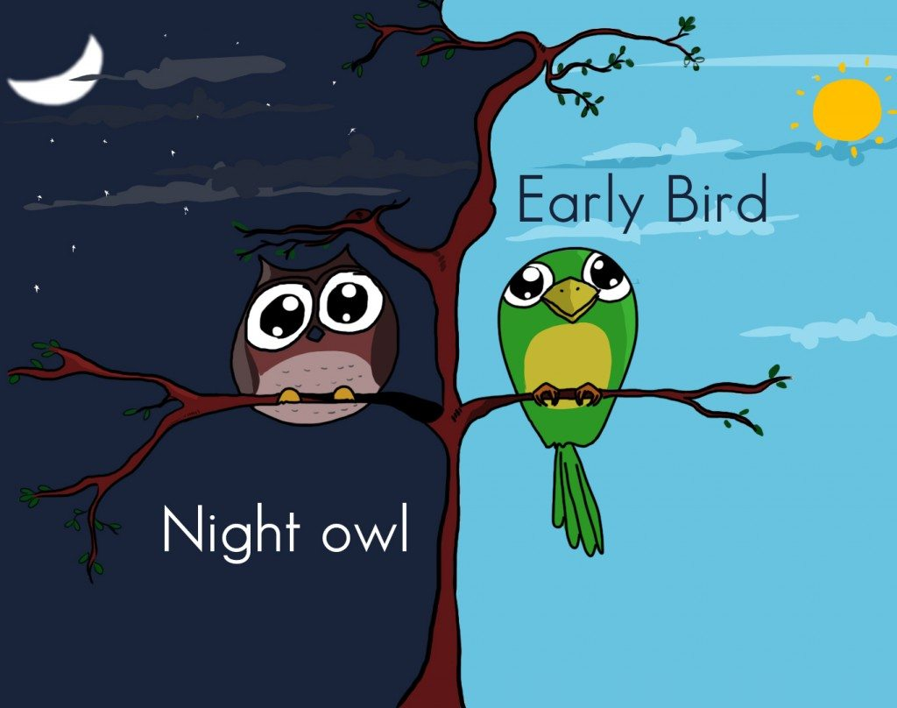
Quantitative Email Study: Goals
Examine
The "past" (remote learning/working)
The "present" (in-person learning/working)
Identify
"Early birds" (Morningness)
"Night owls" (Eveningness)
Analyze how morningness/eveningness chronotypes impact individuals in different contexts

Slide 13
Qualitative Study: Hypotheses
Research is primarily descriptive
Phase 2: we predict that individuals with
Those who score high on Neuroticism and Trait Anxiety
More sleep & well-being problems both past & present
Problem family situations (e.g., young children, elderly parents)
Better sleep and well-being during the present than the past
High Extraversion will have worse scores during the past than the present
On sleep, depression, anxiety, quality of life

Slide 14
Thank You! Questions?
?

