Slide 1
Doing Ordinary Things Extraordinarily Well: Faculty Perspectives on Excellence in ICT and E-Learning Use in Colleges
Mary Jorgensen and Alice Havel
In Collaboration with
Catherine Fichten, Laura King, Jillian Budd, Alex Lussier, Christine Vo, Cristina Vitouchanskaia, Jennison Asuncion, Mai Nhu Nguyen, Alexandre Chauvin, Evelyne Marcil & Laura Schaffer
5th Annual SALTISE Conference, June 3, 2016, Montréal, Québec

Slide 2
Goals and Method
Examine and compare student and faculty perspectives on use of ICTs
311 students from 1 English and 1 French language Cegep
114 of the professors nominated by students for excellent use of ICTs

Slide 3
Method (cont’d)
Checklist of technology used by professors
Semi-structured interview
Example of Questions:
What challenges have you had using computer technology, and how did you overcome them?
Interrater reliability = 86%

Slide 4
Professor Characteristics
Language of Cegep:
English (54%)
French (46%)
Sex: Female (40%), Male (60%)
Program:
Social science (34%)
Science (37%)
Arts (28%)
Notes:
Career = 46% (CAL did not have a career arts program)
Pre-university = 54%

Slide 5
Students and Professors Agree

Slide 6
Students and Professors Don’t Always See Eye to Eye

Slide 7
Faculty Views: Using Technology in Teaching is not Always Easy
Technical Problems
Computers do not work or work slowly
Course Management System crashes
Files exceed Dropbox limit
Institutional Problems
Need to upgrade hardware / software
Network down or slow
Problems with logins
Notes:
Insitutional problems = Incompatability of software versions at the college and at home

Slide 8
Faculty Views: Using Technology in Teaching is not Always Easy
Student-Related Concerns
Overestimation of their own ability
Inappropriate use of personal technology in class
Professor-Related Concerns
Time constraints
Lack of knowledge
Overreliance on technology
Notes:
Student-related concerns: Different levels of ability in using technology

Slide 9
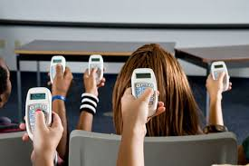
Faculty Wishlist: Hardware / Software
Smart Boards
Clickers
Other
More MACs at the college
Better access to computer lab for class
Specific software requests

Slide 10
Faculty Wishlist: Knowledge of how to use Technology
Workshops Offered by College
Pedagogical day scheduling and content
Videos and online tutorials
Professional Development
Smart Board
Moodle
Clickers

Slide 11
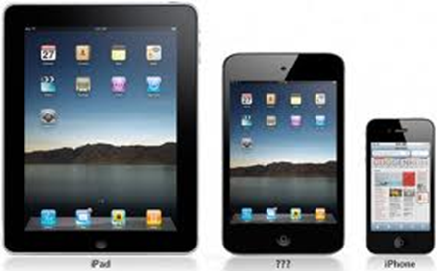
Faculty Views: Students with Disabilities, Second Language Learners
Technology-Related Changes
Allow student use of personal technology in class
Provide access to professor’s course notes
Caption videos
Notes:
1) Few changes in the use of technology: Allow additional time for exams and labs
2) No changes needed as everything is accessible to all students: Universal design, Flexibility
Least common response had to do with actual technology changes.

Slide 12
Student Views: Use of Personal Technology in Class

Slide 13
Comparison of Student and Faculty Views About Use of Personal Technology in Class

Slide 14
Take Home Messages
It’s not only what technology is being used, but how well it’s used
There’s a gap between students’ technology-related wants and professors’ practices
There’s a need for more institutional support and accessible training
Notes:
Course notes, attendance, and tests / quizzes online, as well as clickers, Smart Boards and virtual office hours: Gap between students and teachers
More institutional support: time and opportunity to learn how to use technology in an accessible format

Slide 15
More Information
Mary Jorgensen
mjorgensen07@ubishops.ca
Alice Havel
ahavel@dawsoncollege.qc.ca
Thank you!

