Slide 1
Chronotype and Sleep Quality during Remote and In-Person Activities in an Academic Context
Costin, G. (2023, March 30). Chronotype and sleep quality during remote and in-person activities in an academic context [Invited speaker]. McGill University Honours Research Seminar, Montreal, QC, Canada.
PSYC380D Honours Research Seminar
2001 avenue McGill College
March 30, 2023

Slide 2
Presented by Georgiana Costin Research Assistant and Honours Psychology Student at the Adaptech Research Network Supervised by Dr. Catherine Fichten

Slide 3
Theoretical Background : COVID-19 and Sleep
Sleep can be affected by different stressors
Negative factors:
Uncertainty, worry
Grief
Isolation
Pre-existing health or mental health conditions
Reduced physical activity
Positive factors:
Lack of commute
Flexibility/comfort from studying/working from home
Hyun et al., 2021; Saguem et al., 2022; Wang et al., 2022
Notes:
Open more broadly that sleep can be impacted by stressors
Sort these factors in positive and negative factors
Working studying from home: both positive and negative (pros and cons)

Slide 4
Theoretical background : Chronotype
Chronotype: our body’s natural disposition to want to sleep or be awake at certain times
3 chronotypes:
Morningness (“early birds”)
Intermediate or neither
Eveningness (“night owls”)
Notes:
Older adults tend to be more morning, college students are more evening
Citations on this slide
(Zhou et al., 2020 ; Glavin et al., 2021, Roeser et al., 2012 ; Bakotic et al., 2016) Morningness has been linked to better grades, more social support and mindfulness. Morning or intermediate types tend to have a lower risk of poor sleep compared to evening types. (Enright et al., 2017 ; Sun et al., 2019 ; Walsh et al., 2021)

Slide 5
Theoretical background : Chronotype
Morningness associated with:
Lower risk of poor sleep
Better grades
More social support
More mindfulness
Eveningness associated with:
Poorer sleep quality
Worse psychological well-being
Greater daytime dysfunction
Higher stress responses
More frequent substance use
Intermediate chronotype associated with:
Lower risk of poor sleep
Zhou et al., 2020 ; Glavin et al., 2021 ; Roeser et al., 2012 ; Bakotic et al., 2016 ; Enright et al., 2017 ; Sun et al., 2019 ; Walsh et al., 2021

Slide 6
General Aim
What role has chronotype played in affecting sleep quality during the remote and in-person periods of the pandemic?
Specifically: faculty, non-teaching staff and students
Notes:
More specific in terms of who I am gonna test
Academic context – faculty, staff and students
Leave question and then put specifically in faculty, staff, students

Slide 7
Why is this research important?
Lack of research on chronotype and COVID-19
Contribute to knowledge in the field of sleep
Make recommendations to institutions regarding work and course schedules

Slide 8
Method
Recruited 65 individuals from Dawson College in 2022-2033
22 teachers (86% female; 40% were 55 and over)
21 non-teaching staff (76% female ; 67% were 45 and over)
22 students (59.1% female, 31.8% male, 9.1% other ; 82% were between 18-24)
Email-based study
Participants completed:
Two 10-point questions about their sleep quality (Bailes et al., 2023)
Demographic questions
Reduced Morningness-Eveningness Questionnaire (Chelminski et al., 2000)
Notes:
Write gender, age

Slide 9
Sleep Quality Questions
On a scale of 1 to 10, with 1 being very poor and 10 being very good, overall, what was the quality of your sleep during your last remote / online learning/working/teaching semester?
On a scale of 1 to 10, with 1 being very poor and 10 being very good, overall, what was the quality of your sleep during your most recent in-person learning/working/teaching semester?

Slide 10
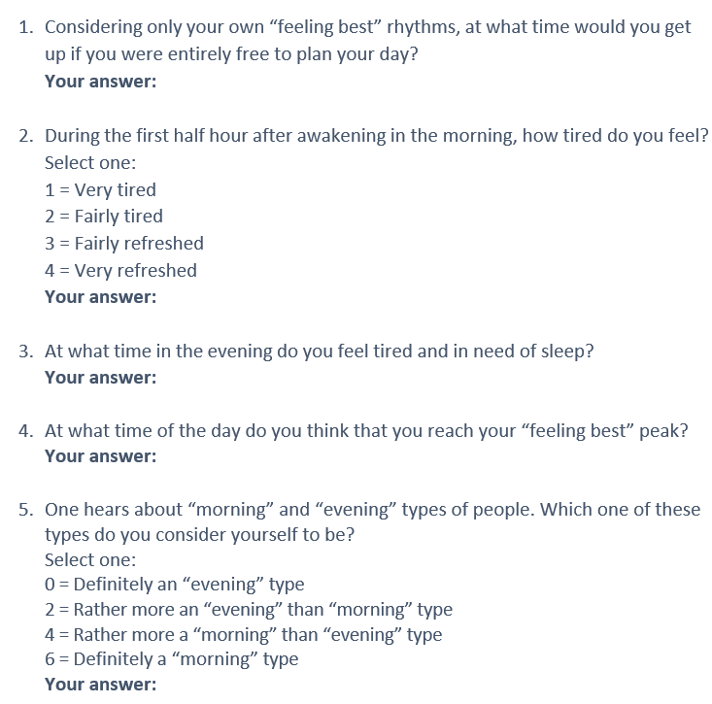
Chelminski et al., 2000

Slide 11
Aim 1
Hypotheses:
Students will have better sleep quality remotely than staff
Students will have better sleep quality during the remote than during the in-person period
How did the COVID-19 pandemic affect the sleep quality of students and staff during remote and in-person activities?

Slide 12
Aim 1 Results: No difference between the groups (p = 0.05), but generally individuals slept better remotely (p = 0.04)
Notes:
Main effect of group : p = 0.05 (not significant), partial eta squared = 0.059
Main effect of period : p = 0.04 (significant) effect size medium partial eta squared of 0.065
Interaction: p = 0.347 partial eta squared = 0.014

Slide 13
Aim 2
Hypotheses:
Eveningness chronotype: Sleep quality remote semester > Sleep quality in-person semester
During the in-person semester: Morningness chronotype > Eveningness chronotype.
Did chronotype impact the sleep quality of post-secondary students, faculty and non-teaching staff during the remote and in-person activities of COVID-19?

Slide 14
Aim 2 Results: Individuals with morningness and intermediate chronotypes slept significantly better than the eveningness chronotype (p < .001)
Notes:
Main effect for chronotype: p smaller than 0.001, partial eta squared = .236 (large effect size)
Main effect of period: p = 0.086, partial eta squared = 0.047
Interaction: p = 0.429, partial eta squared = 0.027
Do stats for the scores of morningness-eveningness rather than group – dr.Titone said I can keep the groups for the presentation though
Change colors

Slide 15
Conclusion
Main aim: What role has chronotype played in affecting sleep quality during the remote and in-person periods of the pandemic?
Aim 1: Sleep quality of staff and students during COVID-19 remote/in-person
No difference in sleep quality between staff and students
Individuals slept better during remote activities
Aim 2: Did chronotype have an impact on sleep quality?
Morningness and intermediate chronotypes slept significantly better than eveningnnes chronotypes

Slide 16
Limitations
Small sample size
Difficult for participants to recall their sleep quality retrospectively
Difficulty recruiting students who were also at Dawson during COVID-19
Disability was self-reported
Notes:
Say some people had disability or not
Indicate limitations I know the answer to
We had unique sample in students – people who took longer to do cegep
Other things going on in the sample that relate to disability
We looked at disability but nothing happened there maybe because sample size too small

Slide 17
Thank you!

Slide 18
References
Bailes, S., Rizzo, D., Fichten, C., Baltzan, M., Grad, R., Creti, L., Amsel, R., & Libman, E. (2023). Should testing for obstructive sleep apnea be offered routinely to older family medicine patients? A prospective cohort study. Psychology, Health & Medicine, 1–14. https://doi.org/10.1080/13548506.2023.2176525
Bakotic, M., Radosevic-Vidacek, B., & Koscec Bjelajac, A. (2017). Morningness–eveningness and daytime functioning in university students: The mediating role of sleep characteristics. Journal of Sleep Research, 26(2), 210–218. https://doi.org/10.1111/jsr.12467
Chelminski, I., Petros, T. V., Plaud, J. J., & Ferraro, F. R. (2000). Psychometric properties of the reduced Horne and Ostberg questionnaire. Personality and Individual Differences, 29(3), 469–478. https://doi.org/10.1016/S0191-8869(99)00208-1
Enright, T., & Refinetti, R. (2017). Chronotype, class times, and academic achievement of university students. Chronobiology International, 34(4), 445–450. https://doi.org/10.1080/07420528.2017.1281287
Glavin, E. E., Ceneus, M., Chanowitz, M., Kantilierakis, J., Mendelow, E., Mosquera, J., & Spaeth, A. M. (2021). Relationships between sleep, exercise timing, and chronotype in young adults. Journal of Health Psychology, 26(13), 2636–2647. https://doi.org/10.1177/1359105320926530
Hyun, S., Hahm, H. C., Wong, G. T. F., Zhang, E., & Liu, C. H. (2021). Psychological correlates of poor sleep quality among U.S. young adults during the COVID-19 pandemic. Sleep Medicine, 51–56. https://doi.org/10.1016/j.sleep.2020.12.009

Slide 19
References
Roeser, K., Meule, A., Schwerdtle, B., Kubler, A., & Schlarb, A. A. (2012). Subjective sleep quality exclusively mediates the relationship between morningness-eveningness preference and self-perceived stress response. Chronobiology International, 29(7), 955–960. https://doi.org/10.3109/07420528.2012.699124
Saguem, B. N., Nakhli, J., Romdhane, I., & Nasr, S. B. (2022). Predictors of sleep quality in medical students during COVID-19 confinement. L’Encephale: Revue de Psychiatrie Clinique Biologique et Therapeutique, 48(1), 3–12. https://doi.org/10.1016/j.encep.2021.03.001
Sun, J., Chen, M., Cai, W., Wang, Z., Wu, S., Sun, X., & Liu, H. (2019). Chronotype: Implications for sleep quality in medical students. Chronobiology International, 36(8), 1115–1123. https://doi.org/10.1080/07420528.2019.1619181
Walsh, N. A., Repa, L. M., & Garland, S. N. (2022). Mindful larks and lonely owls: The relationship between chronotype, mental health, sleep quality, and social support in young adults. Journal of Sleep Research, 31(1), 1–9. https://doi.org/10.1111/jsr.13442
Wang, W., Guo, Y., Du, X., Li, W., Wu, R., Guo, L., & Lu, C. (2022). Associations between poor sleep quality, anxiety symptoms, and depressive symptoms among Chinese adolescents before and during COVID-19: A longitudinal study. Frontiers in Psychiatry. https://doi.org/10.3389/fpsyt.2021.786640
Zhou, J., Hsiao, F.-C., Shi, X., Yang, J., Huang, Y., Jiang, Y., Zhang, B., & Ma, N. (2021). Chronotype and depressive symptoms: A moderated mediation model of sleep quality and resilience in the 1st-year college students. Journal of Clinical Psychology, 77(1), 340–355. https://doi.org/10.1002/jclp.23037

