Slide 1
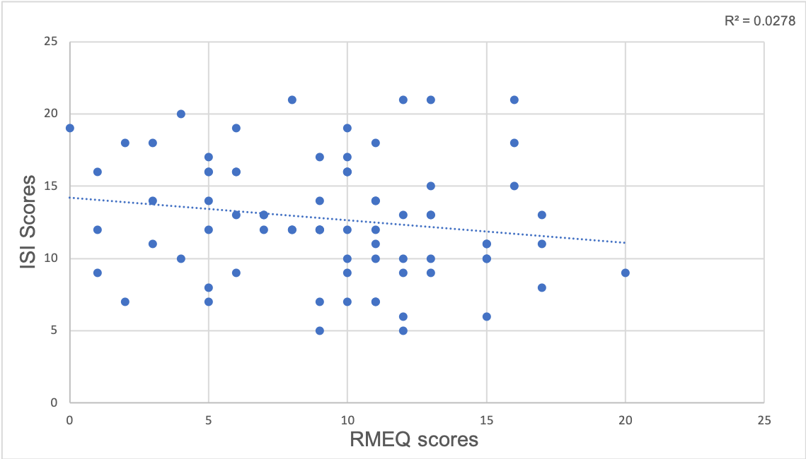
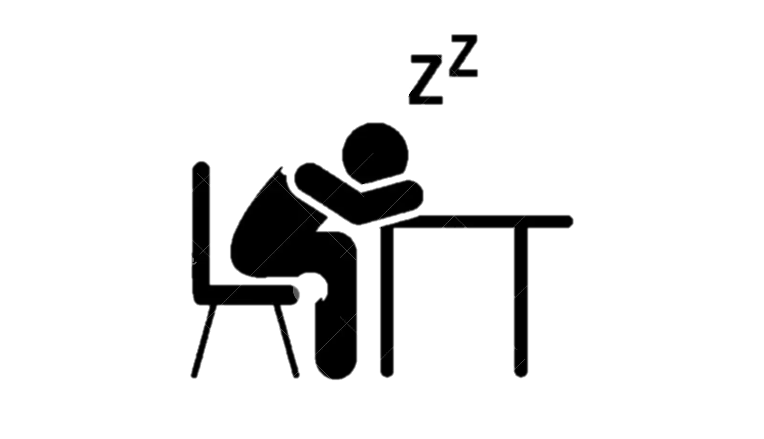
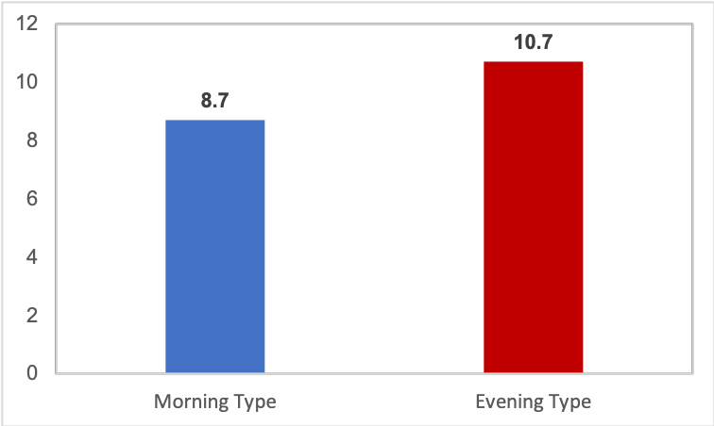
What Keeps You Up at Night?
Chronobiology and Insomnia Levels in Post-Secondary Students
Bianca Zlotea¹, Huanan Liao^{1,3}, Yuxuan Qin^{1,3}, Abi Vasseur^{1,3}, & Catherine Fichten^{1,2,3,4}
Adaptech Research Network¹, Dawson College², McGill University³, Jewish General Hospital⁴
INTRODUCTION
RESULTS
CONCLUSION
Insomnia: The inability to fall asleep and/or to maintain sleep during the night. Waking up earlier than desired is also a characteristic of chronic insomnia.
Chronotype: A natural inclination to want to sleep at a specific time (i.e. night owl vs early bird).
Research questions:
Is there a relationship between chronotype and level of insomnia in students?
Are students who stay up late more at risk of developing insomnia than students who chose not to?
Weak nonsignificant correlation (r= -.16) between insomnia severity scores and chronobiology scores.
Those with an evening chronotype had overall higher insomnia levels than those with a morning chronotype.
There was a weak relationship between levels of insomnia and chronotype in students.
However, we found that those who were evening types reported greater severity of insomnia than those who were morning types.
Implications:
Students who stay up late are not more at risk of developing insomnia than students who choose not to.
Limitations:
Small sample size
No consideration of lifestyle differences
No consideration of program differences
Removed students with an intermediate chronotype
Scatter Plot of ISI vs RMEQ Scores
METHODS
Average Insomnia Score for Each Chronotype
Participants
77 current and former students (within past 5 years) from post-secondary institutions
39 women, 26 men, 2 non-binary
Mean age: 22 years
Questionnaires
ISI (Insomnia Severity Index)
Score range: 0-28
A higher score indicates a greater level of insomnia
RMEQ (Reduced Morningness-Eveningness Questionnaire)
Two chronotypes based on a score ranging from 0-26
Morning type : >12 (n=37)
Evening type: <12 (n=30)
All scores of 12 were removed
RECOMMENDATIONS
Based on our study, future research should look into:
Common factors influencing both insomnia and chronotype
Insomnia levels and chronotypes in students based on different programs of study and lifestyle differences
Factors that predispose students to disturbed sleep patterns in general
and tools to help improve sleep quality
Difference in sleep quality in men vs women
ARC conference 3rd edition (2024). Quebec City, QC,
Canada.

