Slide 1
Parasomnias and Other Negative Sleep Related Phenomena Among Post-Secondary Students With and Without Disabilities
Libman, E., Fichten, C., Creti, L., & Bailes, S. (2023, September 5). Parasomnias and other negative sleep related phenomena among post-secondary students with and without disabilities [Invited speakers]. Psychosocial Rounds at the Jewish General Hospital, Montreal, QC, Canada.
Eva Libman^{1,2,3} Catherine Fichten^{1,2,3,4,5} Laura Creti^{1,2,3} Sally Bailes^{1,2,3}
Alice Havel^{4,5} Bianca Zlotea^{4,5} Georgiana Costin^{1,5} Mary Jorgensen⁵
¹McGill, ²LDI, ³CIUSS, ⁴Dawson College ⁵Adaptech Research Network
Psychosocial Rounds, Montreal, September 5, 2023
https://shorturl.at/mxDGX
Notes:
Scottish Prayer:
From ghoulies and ghosties
And long-leggedy beasties
And things that go bump in the night,
Good Lord, deliver us!

Slide 2
Team Members
Adaptech Research Network
Post-secondary students with and without disabilities
Focus on academic success
JGH Sleep Team
Clinical and research
Focus on sleep and sleep disorder

Slide 3
Overview
Understanding parasomnias
Our research
Preliminary pilot data

Slide 4
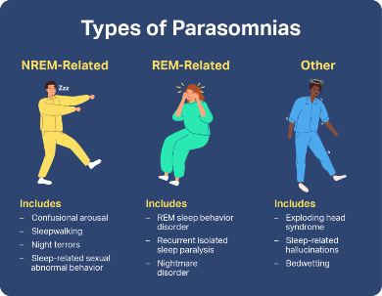
What Are Parasomnias?
During sleep the brain cycles
Wakefulness
NREM sleep
REM sleep
Parasomnias
Classified according to whether they emerged from NREM or REM sleep
Occur when transitions between these stages are incomplete
People are
Amnesic for the content from NREM parasomnias
Usually recall that from REM

Slide 5
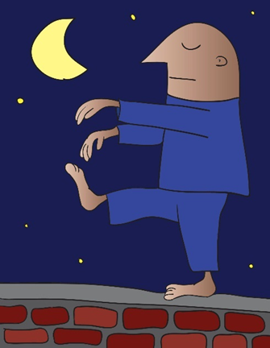
What Are Parasomnias?
NREM-Related Parasomnias
Confusional arousals
Sleepwalking
Sleep talking
Sleep terrors
Sleep-related eating disorder
Sexsomnia (sexual act during sleep)

Slide 6
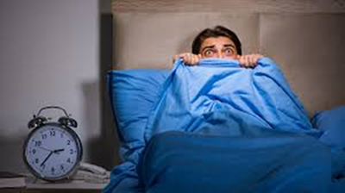
What Are Parasomnias?
REM-related parasomnias
Nightmare disorder
REM behavior disorder
Recurrent sleep paralysis

Slide 7
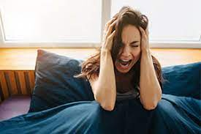
What Are Parasomnias?
Parasomnias emerging in either sleep phase
Exploding head syndrome
Sleep-related hallucinations (hypnogogic/hypnopompic)
Sleep enuresis
Sleep related leg cramps
Sleep related bruxism
Abnormal swallowing

Slide 8
Present Study
FRQS funded project
Catherine, Eva, Laura Creti, Sally Bailes, Alice Havel
Descriptive study
Goal: find out, in a post-secondary population
About parasomnias
Prevalence, impact, coping strategies
Predictors
Resilience and susceptibility
Students with and without disabilities

Slide 9
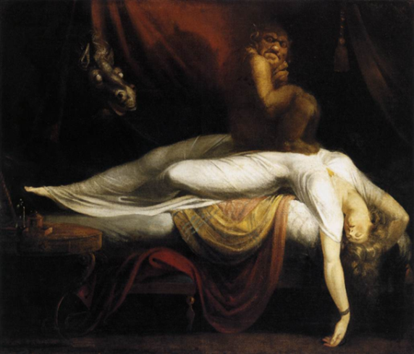
Where Ideas Came From
I gave a talk to students
“I never told anyone. I thought I was crazy!”
Students’ examples
Why I couldn't lose weight
Sleep-related eating disorder
Praying to Mother Teresa
Hypnopompic hallucinations
Recurrent sleep paralysis
A modern exorcism
Pavor nocturnus (Sleep terrors)

Slide 10
Our Research
As Eva mentioned we are interested
Prevalence, impact, coping strategies
Predictors: resilience and susceptibility
Hypotheses: susceptibility
Sleep deprivation
“Poor sleepers”
Multiple different parasomnias
Psychological disorders
ADHD
Hypotheses: resilience = ???
Now: ready to launch project
Waiting for ethics

Slide 11
Advisory Board
Two 1 hr. Zoom meetings with experts
Outside opinions
Animator, 2 note takers
Research team were “flies on the wall”
Questions
What are your thoughts concerning parasomnias and other negative sleep-related phenomena?
What information do you think we need to gather from post-secondary students to
Understand the phenomena
Ultimately make recommendations

Slide 12
Curating English and French Validated Questionnaires
Literature search (French Google, Érudit)
Email colleagues
Email scholars who used the French version
Managed to get most measures BUT
Different French versions differed from each other
Colleagues said they used the measure but it was not validated
Etc. etc.
Had to translate two measures ourselves (DeepL really helped)

Slide 13
Parasomnia Measures
Munich Parasomnia Screening (MUPS): 21 items
During the past year, how often did you experience the following
0= never to 6= very often If ≥ 3 then
How disturbing was this? 1= not at all to 10 = very disturbing
What did you do about this?
Paris Arousal Disorders Severity Scale: 17 items
During the past year, how often did you exhibit the following
0= never, 1 = sometimes, 2= often If ≥ 1 then
How disturbing was this? 1= not at all to 10 = very disturbing
What did you do about this?

Slide 14
Other Measures
Insomnia Severity Index
Chronobiology: Reduced Morningness-Eveningness Scale
Eysenck Personality Questionnaire (EPQ-RA: Neuroticism)
Sleep Questionnaire
Sleep Symptom Checklist
Quality of Life Enjoyment and Satisfaction
Hospital Anxiety and Depression Scale (HADS)
Demographics & disability
Anything else?

Slide 15
Method
Administer 2 linked surveys
Offer Amazon gift cards ($30)
Sample
Email participants in our data bank (2210 students since 2013)
Current students or student during the past 5 years
Past experience
Many emails don’t work any more
Some students not interested
Expect 20% response rate (approx. 400 participants)

Slide 16
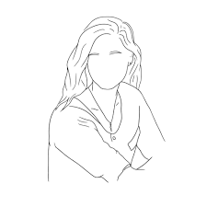
Preliminary Pilot Data: Participant 1
Participant 1: 25 year old female student
Nightmare disorder
MUPS item 13. During the past year, how often did you experience frightening dreams and nightmares: 6 = very often
Confusional awakenings
MUPS item 17. Upon waking, completely confused / difficult orientation / slowed speech: 4 = sometimes
Other
MUPS item 8. Teeth grinding during the night: 5 = often

Slide 17
Preliminary Pilot Data: Participant 1
Context
Sleeps 12 hours during the night plus a 2-hour nap daily
Severe daytime fatigue/sleepiness (despite many hours sleeping)
Concentration and cognitive function appear unimpaired
Competitive sports & social activities have become limited
Perceives she has more energy in the summer
Uses bright light exposure

Slide 18
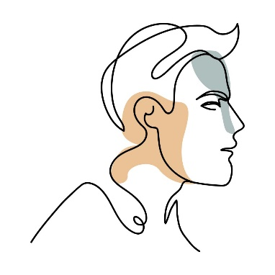
Preliminary Pilot Data: Participant 2
Participant 2: 22-year old male student
Sleep-related movement disorder
MUPS item 1: leg or body twitches that occur suddenly and unintentionally when falling asleep, often with the sensation of falling; 5= often
Confusional awakenings
MUPS item 17; Upon waking, completely confused/difficult orientation, slowed speech; 4=sometimes
Other
MUPS item 8: Teeth grinding: 6=very often
MUPS item 5: Auditory/ visual illusions: 4=sometimes
MUPS item 13: Nightmare disorder frightening dreams and nightmares; 4=sometimes

Slide 19
Preliminary Pilot Data: Participant 2
Context
Main complaint was overwhelming daytime fatigue
Interfered with ability to complete assignments (although good student)
Relatively frequent nightmares & vivid dreams reported as unpleasant
But not distressed by these
Learned to wake himself up from these
Then walk around to calm himself down & return to bed
Also a constitutionally long and delayed sleeper
Contributed to sleep deprivation

Slide 20
Preliminary Pilot Data
Context
Main complaint was overwhelming daytime fatigue
Interfered with ability to complete assignments (although good student)
Relatively frequent nightmares & vivid dreams reported as unpleasant
But not distressed by these
Learned to wake himself up from these
Then walk around to calm himself down & return to bed
Also a constitutionally long and delayed sleeper
Contributed to sleep deprivation

Slide 21
Our Parasomnia Story So Far
Importance of stakeholder experts for diverse viewpoints
Bilingual studies are difficult
More than one parasomnia may be common
Importance of subjective perception as well as objective score

Slide 22
Questions
PPT available at: https://shorturl.at/mxDGX
Eva Libman: eva/libman@mcgill.ca
Catherine Fichten: catherine.fichten@mcgill.ca
Laura Creti: laura.creti@mcgill.ca
Sally Bailes: sally.bailes@mcgill.ca
Alice Havel: ahavel@dawsoncollege.qc.ca

