Slide 1






The Potential of Mobile Technology
Catherine Fichten, Laura King,
Mary Jorgensen, Alice Havel
5th Ed-ICT International Network Symposium
Newport Pagnell, England, June 11-13, 2019

Slide 2

Current Research
Goal: to better understand
  Students’ use of mobile devices
Collaboration with Israeli Ed-ICT team
  Tali Heiman, Dorit Olenik-Shemesh, Dana Kaspi-Tsahor
4 focus groups, n = 29
  Students without disabilities
  Students with disabilities
  Professors
  Professionals

Slide 3
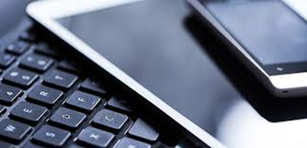
How Do Students Use Their Mobile Devices?
  Mobile devices
    Smartphones
    Laptops
    Tablets
  Inappropriate uses in class
  Appropriate uses
    In class
    Out of class

Slide 4
http://www.adaptech.org
Personal Mobile Devices
  Why do some professors prohibit their use?
  What activities require use of students’ devices?
  What can be done to allow students to use their devices for appropriate academic activities in class?

Slide 5

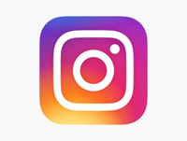


In Class Inappropriate Uses
Text and email
Check
  Facebook
  WhatsApp
  Instagram
  Snapchat
Play computer games
Shop online
Watch videos
Work on assignments for other classes

Slide 6
Appropriate Uses In Class
Facilitate note-taking
  Record lecture
  Take pictures of blackboard, PowerPoint slides
Follow projected PowerPoint on mobile device
Respond to professor initiated activities
  Kahoot, Poll Everywhere
Group work
Search, translate

Slide 7
Appropriate Uses Out of Class
Google Docs, PowerPoint slides, etc.
Begin essays on bus
Access online library services
Read digital textbooks
Submit assignments online
Make course related videos
Participate in course blogs
Provide visual proof of activity

Slide 8

Good Practice for Accessibility
Apps to help students focus
  Forest
  Focus Lock
Mindly for schematic maps
Antidote for correction
Texting to cope with anxiety
Convert images, handouts to digital text
  Seeing AI

Slide 9

Implications for Professors
Allow use of mobile tech in class!
Provide guidelines for appropriate uses
    Include rationale for guidelines
Integrate mobile devices
    Into teaching
    Into out of class learning activities
  Use universal design paradigm
Show how tech can help students focus

Slide 10

Future Research
  Mobile tech use in other countries
  Links between mobile tech use & grades
  Design and validate questionnaires
    Mobile tech and students with disabilities
    Academic uses of mobile tech
      Students with & without disabilities
      Professors & professionals
      Other stakeholders
Notes:
Learning technologists, instructional designers
Administrators, IT specialists, textbook and cms vendors

Slide 11
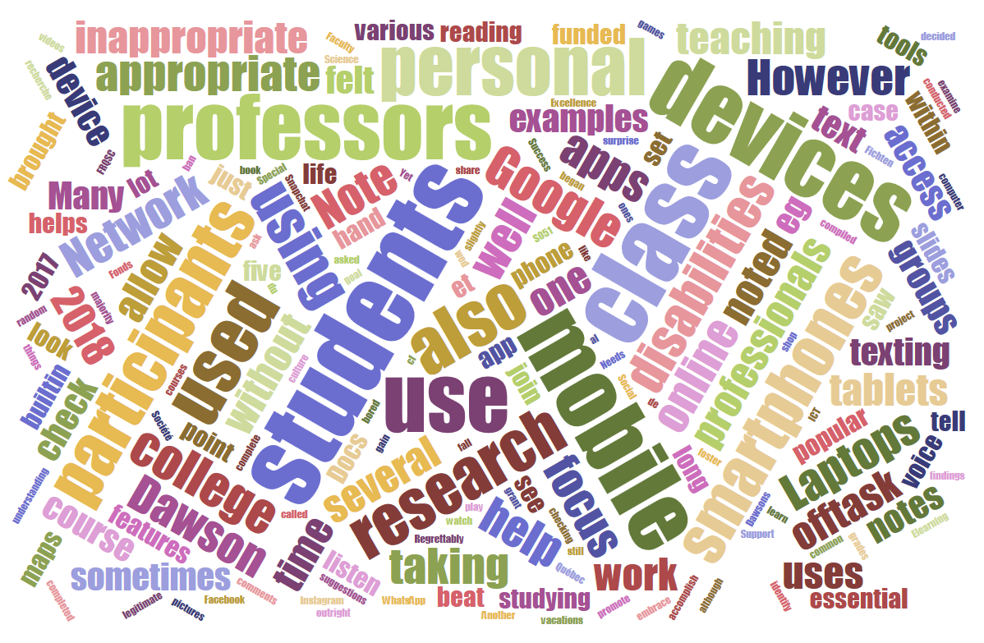
Contact Information
  Catherine Fichten
  cfichten@dawsoncollege.qc.ca
  Laura King
  laura.king@claurendeau.qc.ca
Alice Havel
  ahavel@dawsoncollege.qc.ca
Adaptech Research Network
  www.adaptech.org

