Slide 1






Data Driven Instructional Design: Higher Learning Student and Professor Voices
Laura King and Mary Jorgensen
In Collaboration with
Catherine Fichten, Alice Havel, Jillian Budd, Alex Lussier, Christine Vo, Cristina Vitouchanskaia, Jennison Asuncion, Mai Nhu Nguyen, Alexandre Chauvin, Evelyne Marcil & Laura Schaffer
19th Annual Accessing Higher Ground: Accessible Media, Web & Technology Conference
November 16, 2016: Westminster, Colorado

Slide 2
Overview

Slide 3
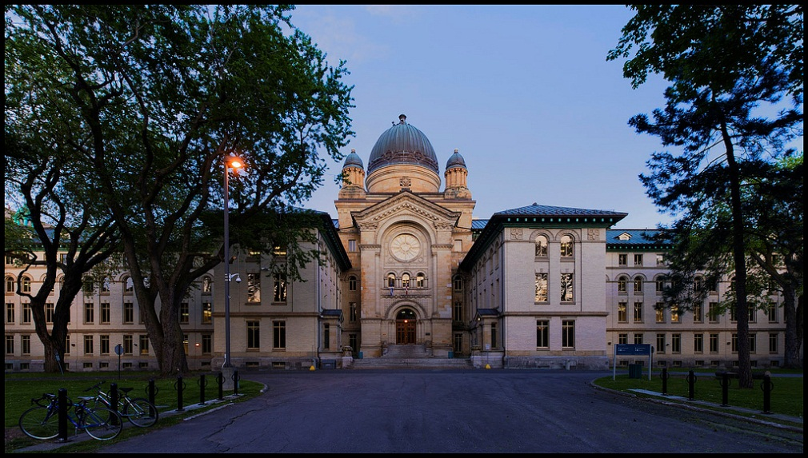
Presenters
Mary Jorgensen
- Adaptech Research Network
- Research Associate and Statistician
mjorgensen07@ubishops.ca

Slide 4
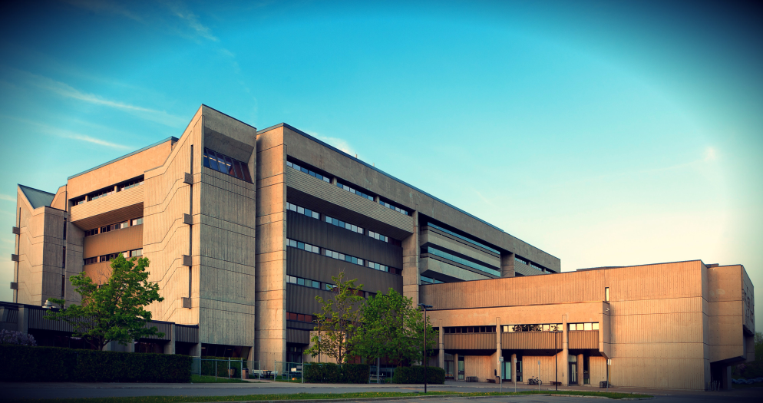
Presenters
Laura King
- Adaptech Research Network
- André-Laurendeau College
laura.king@claurendeau.qc.ca

Slide 5
Key Points for Today’s Presentation
Framework key findings within a UDL perspective
Identify ICTs that students and professors say work well
Highlight ICT differences between students and professors

Slide 6
Research Overview
Student and faculty perspectives on excellence in ICT and e-learning use
Phase 1: Students’ perspective
Phase 2: Professors’ perspective
Phase 3: Compare and contrast

Slide 7
Methodology

Slide 8
Phase 1: Students
Completed an online survey
  Accessible
  Usable
  Questions
  Checklist

Slide 9

Phase 1: Examples of Survey Questions
What technologies have your professors used in class?
Which of these technologies worked well for you?
Which of these technologies did not work well for you?

Slide 10
Student Characteristics
Sex
    Female : n = 183 (59 %)
    Male : n = 126 (40 %)
Program of Study
    Pre-university : n = 210 (68 %)
    Career / technical : n = 94 (31 %)

Slide 11
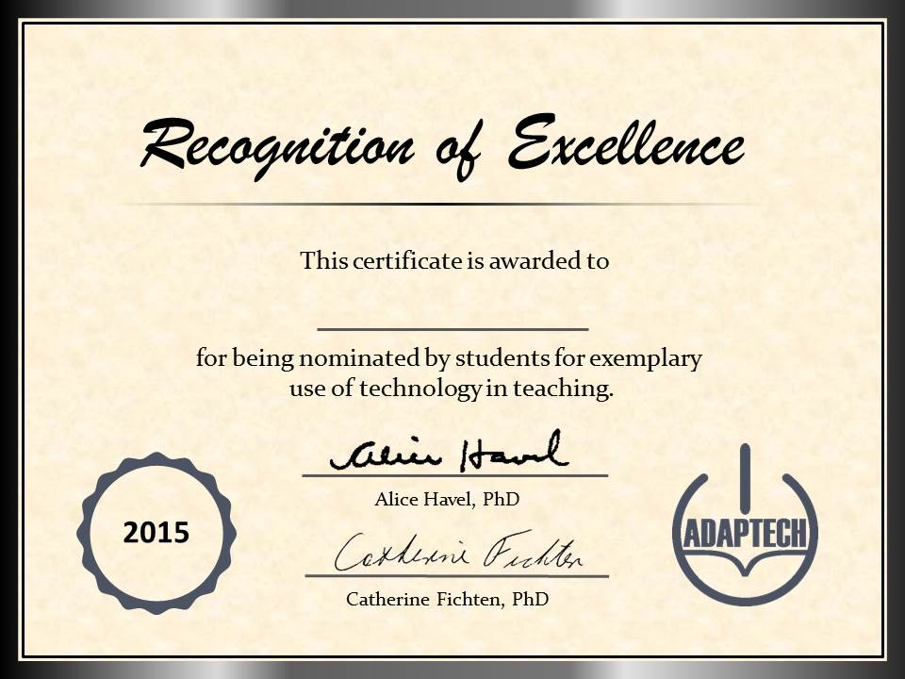
Phase 2: Professors
Semi-structured interviews
Checklist of technologies used

Slide 12
Phase 2: Examples of Interview
What helps you use computer technology effectively in your teaching?
Is there any type of computer technology that you wish you could use in your courses?
Complete the checklist below.

Slide 13
Professor Characteristics
Language of Cegep:
  English (54%)
  French (46%)
Sex: Female (40%), Male (60%)
Program:
  Social science (34%)
  Science (37%)
  Arts (28%)

Slide 14
Results

Slide 15
Students: No Significant Differences
Born outside of Canada
Gender
Language of instruction
Disability

Slide 16
I like courses where professors use technology

Slide 17
ICTs Frequently Used by Professors
 | n | Worked well
Grades posted online | 298 | 99%
Presentation software | 298 | 98%
Assignments posted online | 297 | 97%
Course notes posted online | 271 | 97%

Slide 18
What Did Not Work Well
Presentation-software Crimes
Professors’ use and knowledge of technology
Online communication
Performance of technology at school

Slide 19

Connecting the Dots
What is the connection between ICTs and universal design (UD)?
Are ICTs a gateway to UD?
Interact / Reflect

Slide 20
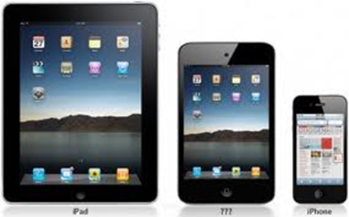
Students with Disabilities, Second Language Learners
Technology-related changes
  Allow student use of personal technology in class
  Provide access to professor’s course notes
  Caption videos

Slide 21
Facilitators: How Professors Learned to Use Technolgy
Learns on one’s own
  Trial and error
  Online resources
Previous experience with technology
  Work in industry
Help from colleagues, support staff
Worshops offered by the college

Slide 22
Obstacles: Using Technology can Have its Challenges
  Technical problems
    Computers do not work or work slowly
  Institutional problems
    Need to upgrade hardware / software
Student-related concerns
  Inappropriate use of their own tech in class
Professor-related concerns
    Over-reliance on technology

Slide 23
Inspirational Uses of ICTs
Has student use cell phones to create paper negative portraits to simulate the experience of photography of the 1880s
Wacom Tablet
Ozobot
Swivl
ARDUINO boards
BeeWorks

Slide 24
Students and Professors Agree

Slide 25
Students and Professors Differ

Slide 26
Use of their own Technology in the Classroom

Slide 27
Comparison of Student and Faculty Views About Use of Personal Technology in Class

Slide 28
Connecting the Dots
Differences
Where is the common ground?
Interact / Reflect

Slide 29
Conclusion

Slide 30
Practical Applications: Need for UD Framework
Presentation software
Communication
Teaching technology
Online textbooks / Group work

Slide 31
Take Home Messages
Effectiveness of ICT use
All on board
UD is achievable

Slide 32

Questions

Slide 33

Thank you for your attention

Slide 34
More Information
  Mary Jorgensen
  mjorgensen07@ubishops.ca
  Laura King
  laura.king@claurendeau.qc.ca
www.adaptech.org

