Slide 1
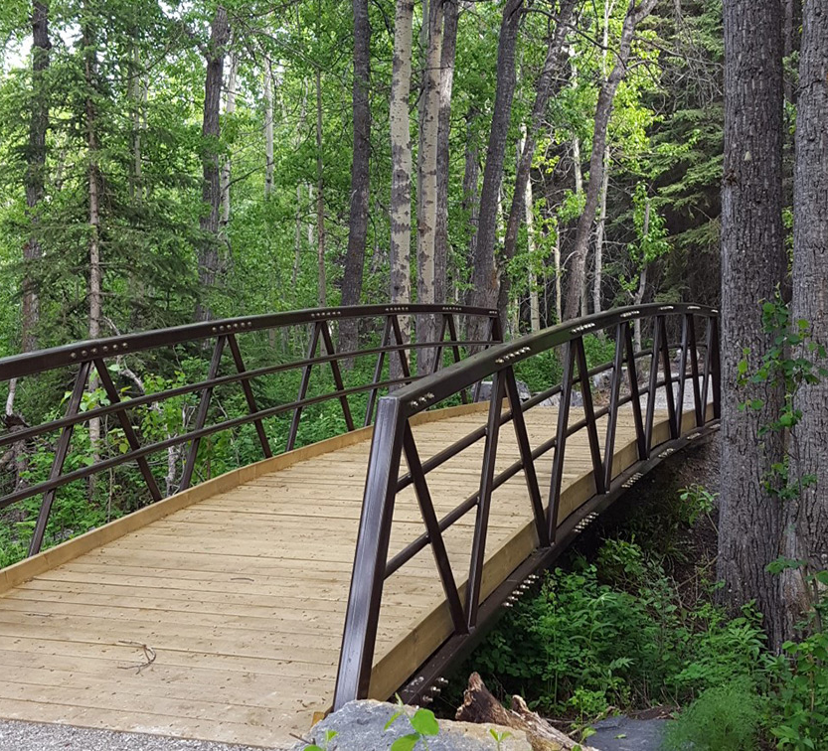
Best Practices in Supporting Students During Internships
Wileman, S., Havel, A., Fichten, C., & Jorgensen, M. (2024, January 9). Best practices in supporting students during internships Învited speakers]. Intercollegiate Pedagogical Day, Montreal, QC, Canada.
Susie Wileman, Alice Havel, Catherine Fichten, Mary Jorgensen
Adaptech Research Network
January 9, 2024
IPD 2024
Shifting Landscapes: Shared Practices in a Changing Cegep System

Slide 2
Who Are We?
Why Now?
Adaptech Research Network
Dawson College
ECQ
UD
Success stories vs. Pushback
Silos of Knowledge
Notes:
.

Slide 3
Canadian Post-secondary Students with Disabilities
18 – 34% (Canadian University Survey Consortium, 2020, 2021; Fichten et.al., 2018, 2019)
↑ Accessibility supports in academic settings (Fichten, Havel, Tremblay et.al., 2022)
Need for equitable access in clinical internships (Neal-Boylan, et.al., 2018)

Slide 4
Review of Literature
2015 to 2023
Focus on health & human service programs
Importance of communication
Lack of shared information and resources
Suggestions for accommodations
Notion of technical standards versus essential functions
https://adaptech.org/fr/publications/annotated-bibliography-equitable-access-in-internship-settings/

Slide 5
Goals of the Project
Explore facilitators and barriers
Include voices of three stakeholder groups
Create ‘deliverables’

Slide 6
Method
Advisory Board Meeting
Faculty
Dean
Students with disabilities
Accessibility Centre Advisor
Pedagogical Counsellor
Individual Interviews x 3 groups
Faculty fieldwork/clinical supervisors (n. 10)
AccessAbility Centre advisors (n. 8)
Students with disabilities (n. 14)
Thematic Analysis

Slide 7
Questions We Asked
Students
Facilitators
Barriers
Resources
assistive technologies
strategies
Role of the college
Recommendations
Faculty
Service Providers

Slide 8
What Students Told Us
Need support for
Communication
Disclosure
Assistive tech
Mentorship / role models
Visual representation of materials

Slide 9
What Faculty Told Us
Faculty Internship Supervisors need clarity
Policy and protocol
Confidentiality regulations
Guidelines / best practices

Slide 10
What Accessibility Advisors Told Us
Need clarity
Competencies being measured
Fieldwork settings and appropriate accommodations
College policy and protocol
Best practices / models of success

Slide 11
Emerging themes
ROLE OF ACESSIBILITY SERVICES
Institutional Policy & Legislation
Communication
Knowledge

Slide 12
Toolkit
1. Digital Handouts:
Annotated Bibliography: Equitable Access in Internship Settings
Is There a Law, or Not?
UDL for Clinical Educators
Key Steps to Inclusion in Clinical Internship Settings
2. Resources: What’s Already Out There
3. Videos
https://adaptech.org/research/internship-toolkit-for-students-with-disabilities-in-technical-programs/

Slide 13
Key Steps to Inclusion
Match students to internship sites that can best meet their needs
Allow for the responsible use of mobile technology such as cell phones or iPads
Provide accommodations when needed
Communication between student, on-site and faculty supervisors and Access advisor is key
Relevant legislation and institutional policies on inclusion should be considered

Slide 14
Videos
How-tos demonstrating tech
Video on how technology is being used in clinical settings, and
Video on disclosure
https://adaptech.org/research/internship-toolkit-for-students-with-disabilities-in-technical-programs/

Slide 15
Tech Tips for Internships
https://youtu.be/aCa29_E-FE8

Slide 16
Inclusive Internships - Cut to the Chase [Video]
https://youtu.be/XCFfAgABVLs

Slide 17
Questions / Comments

Slide 18
Thank you!
Adaptech Research Network www.adaptech.org
Alice Havel ahavel@dawsoncollege.qc.ca
Susie Wileman swileman@dawsoncollege.qc.ca
Catherine Fichten
catherine.fichten@mcgill.ca
Mary Jorgensen
mjorgensen@dawsoncollege.qc.ca
Funded by Entente Canada-Quebec
​
WilemanIDP2024.pptx

