Slide 1








A Partnership in the Making?
Havel, A., Wileman, S., Iravani-Manesh, G., Fichten, C., & Jorgensen, M. (2022, January 20). A partnership in the making [Invited speakers]? Accessibility and Inclusion (CACUSS) Leadership Team, Montreal, QC, Canada.
Alice Havel, Susie Wileman, Guissou Iravani-Manesh,
Catherine Fichten, and Mary Jorgensen
Adaptech Research Network
Presentation to the Accessibility and Inclusion (CACUSS) Leadership Team
January 20, 2022

Slide 2

Agenda
What is the Adaptech Research Network
Type of research conducted
Salient findings
Ongoing research
Suggestions for future research

Slide 3

What is the Adaptech Research Network?
Adaptech
  https://adaptech.org/
  Team of teachers, professionals, students, researchers
  Conduct research on post-secondary students
    With and without a variety of disabilities
  Focus on information and computer technologies
  Based at Dawson College

Slide 4
Students with Disabilities in 2022
  Self-reported disability: 11%-17% of students
  ≈ 2/3 not registered for campus disability services
  Mainly students with
    Learning disability/ADHD
    Mental health conditions
    Chronic health conditions
  ≈ 50% have multiple disabilities

Slide 5

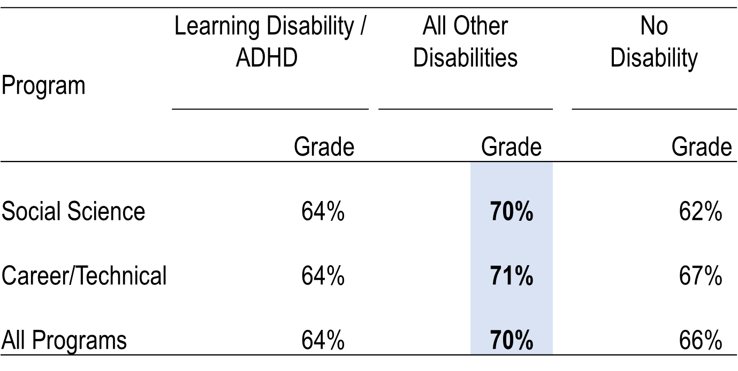
Grades
College 6-year archival study

Slide 6

College Graduation

Slide 7

Sleep and Well-Being in Post-Secondary Populations
    Remote / online teaching, learning and working
    Back to face-to-face teaching, learning and working
    Positive and negative experiences
      For whom (gender, age, disability, group)
        Student, faculty, non-teaching staff
        With and without disabilities
  Given "back to face-to-face" how can
    Positive outcomes be maximized
    Negative outcomes be mitigated

Slide 8

Internship Toolkit for Students with Disabilities in Technical Programs
Goal to facilitate internships of students with disabilities in technical programs:
Health-related (nursing, diagnostic imaging, physiotherapy, etc.)
  Social service
  Community recreational leadership

Slide 9
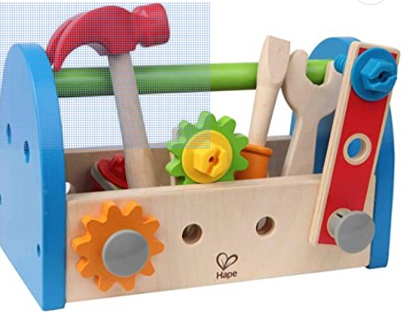
Internship Toolkit for Students with Disabilities in Technical Programs – Cont’d
Interviews with key stakeholders
  Students
  Faculty internship supervisors
  Adapted services counsellors
Identify recommendations
  Successful techniques, strategies
Toolkit
  Recommendations and case examples of best practices

Slide 10
Reference
Adaptech Research Network /
Réseau de Recherche Adaptech
https://adaptech.org/

Slide 11

Thank You!
Adaptech Research Network: www.adaptech.org
Alice Havel: ahavel@dawsoncollege.qc.ca.ca

