Slide 1



Browser Extensions For All:
“We’re Different, We’re the Same”
Arcuri, R., Vo, C., Fichten, C., Jorgensen, M., Harvison, M., & Vasseur, A. (2021, November 15-19). Browser extensions for all: “We’re different, we’re the same” [Conference presentation]. 24th Annual Accessing Higher Ground: Accessible Media, Web and Technology Conference, Denver, CO, United States.
Rosie Arcuri, Christine Vo, Catherine Fichten, Mary Jorgensen, Maegan Harvison and Abi Vasseur,
Adaptech Research Network
Accessing Higher Ground Conference,
November 18, 2021

Slide 2
Agenda
PowerPoint presentation
  What are chrome extensions
  How do you download chrome extensions safely
  Chrome extensions for reading, writing, note taking, productivity, alternative mice/ keyboard
  An alternative for assistive technology (AT)
Video / Demonstration
Questions

Slide 3

Introduction
Google Chrome is the most popular browser in North America
Most students with disabilities, especially those with ADHD, mental health and LD chose not to use AT’s
  Cost
  Fear of being singled out
  Lack of training

Slide 4

This Initiative
180 relevant extensions compiled
100 extensions deemed safe
  Updated in 2019 or later
50 extensions tested
  Unique function
  Popularity
  Customer reviews

Slide 5
What is an Extension?
Programs that change the browser experience by:
  Adding a function
    Display: background color, text size, remove adds and distractions
    Website and tab navigation: use the keyboard or mouse to alter navigation

Slide 6

What is an Extension? (2)
Linking to external services
  Spell and grammar checkers
  Productivity and organizational tools
  Text-to-speech and other reading tools

Slide 7
Safety Tips
Is this extension from a developer that is a trusted source?
Is the developer's website consistent with the information on extension page on the Google Chrome store?
Are the extension's permission requests consistent with the features of the extension?
  Source: Assessing Safety Extension

Slide 8

Safety Tips (2)
Does the extension's description or website explain why they need those permissions?
Does the extension have a privacy policy, and am I comfortable with how the data is being used under the privacy policy?

Slide 9

How to install an extension
Sign into your Chrome (Gmail login)
Open the Chrome Web Store.
Search for an extension
Click Add to Chrome.
If prompted, click Add extension
(Source: Chrome Webstore)

Slide 10
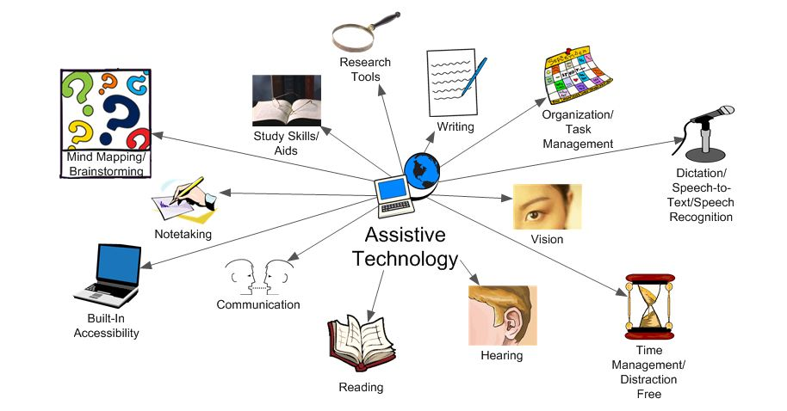
What is Assistive Tech (AT)

Slide 11

AT vs Extensions - AT
Often expensive
Students avoid due to fear of stigma
Comprehensive tools can be overwhelming to learn
Designed for specific needs
More training available

Slide 12

AT vs Extensions - Extensions
Often free or inexpensive
Used by the general public
Simple or complex
May require many extensions to replace comprehensive AT program
Information not always available
Minimal training

Slide 13

Comprehensive literacy tools
$99 annually
  Compared to $0-50
Comprehensive tools
  Common tools found in other extensions
  Uncommon tools such as OCR and picture dictionaries

Slide 14

Comprehensive Literacy Tools - Examples
  Read&Write: word prediction, highlight protection, summarize text
  Helperbird: most comprehensive with content, display, navigation, and other disability specific features

Slide 15

Reading
Common features
  Change text size, color, spacing and background
  Text-to-speech
  Removing distractions

Slide 16


Reading (2)
Extensions
  Clearly Reader
  Helperbird
  Read Aloud: A Text to Speech Voice Reader

Slide 17


Reading (3)
Unique features
  Word cloud
    Word Cloud Generator
  Ruler or color change
    BeeLine Reader

Slide 18



Writing
Spell and grammar checker
  Grammarly is most common & free, Microsoft editor
Improve writing
  Outwrite: give hints to improve writing
  Quillbot: summarizing and paraphrasing

Slide 19

Writing (2)
Dictation – speech-to-text
  Voiceln: works in most textboxes including docs, and outlook
Text-to-speech (review)
  Speechify and Clearly reader stay on the site
  Read & Write and Kami move to new platform, more complex but paid

Slide 20


Writing (3)
Dictionary
  Regular and picture dictionary
    Google Dictionary simple to use
    Read&Write
Word prediction
  Read&Write
  ClaroRead – somewhat inconsistent

Slide 21

Note-Taking
Common features
  File management
  Notes websites
  Save screenshots
  Annotate on files (web, pdf, screenshots)

Slide 22



Note-Taking (2)
Extensions
  Evernote Web Clipper – most comprehensive
  OneNote Web - no annotations
  Google Keep - simple but effective

Slide 23

Productivity
Organize documents
  Google Keep, OneNote web clipper, Evernote Web Clipper all work very well
Simplified view
  Clearly Reader (for web), Print Friendly and PDF

Slide 24



Productivity (2)
Timers
  Marinara - simple and free
  BlockSite - paid but offers series of timers
To do lists / project management tools
  Keep - basic checkbox
  Todoist and Asana - project management

Slide 25


Productivity (3)
Website blockers
  BlockSite - comprehensive but paid
  Leech Blocker NG - limited options but free
Tab management
  Dualless - mimics having two screens

Slide 26



Mice alternatives
Controlling the browser
  Without scrolling
    Caret (Google Partner)
    Vimium offers fully mouse less experience
Mouse gestures
  CRZMouse effective but requires right clicking

Slide 27
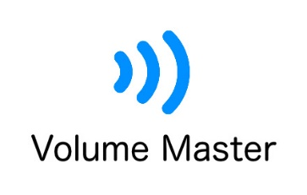


Disability Specific: Hearing
Volume, control and captions
  Ultimate volume booster
  Volume master - increases volume
  Otter.ai - caption

Slide 28

Disability Specific: Seeing
Change in display, magnification, text-to-speech (TTS) basic screen reading
  Eye-Able Accessibility assistant - most comprehensive TTS tool, keyboard navigation on menus
  Zoom- similar to chrome zoom settings but more incremental

Slide 29

Disability Specific: Dyslexia
Changing font to make it easier to identify letters
  OpenDyslexic - Works well for web raiding, generally works well on google pages
Notes:
There were many! We wanted to find out

Slide 30
Students Who Should Consider Extensions
Hesitant to use AT due to fear of stigma
Do not have AT funding or training
Need minimal support
Have some tech experience
Are not afraid to try and test options

Slide 31
Students Who May Not Want to Use Extensions
Already use a tool they find works well
Want to learn only one tool
Have complex or specialized needs
Need 1:1 training
Are anxious about using tech
Are using a screen reader or voice recognition

Slide 32
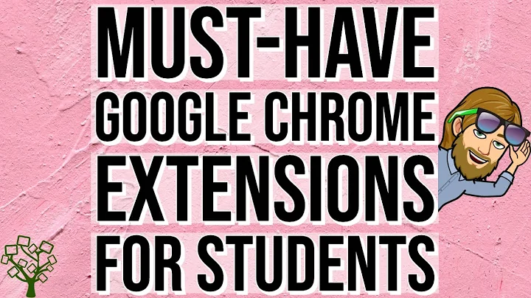
Demonstration and resource
For moreinformation please watch: Must-Have Google Chrome Extensions for Students

Slide 33

Thank You!
Adaptech Research Network: www.adaptech.org
Rosie Arcuri: rosie.arcuri@mail.mcgill.ca

