Slide 1
Transitions for students with disabilities and technology: Better in Theory than Practice
Havel, A., Fichten, C., King, L., & Jorgensen, M. (2018, October). Transitions for students with disabilities and technology: Better in theory than practice. Presentation at the 4th Ed-ICT International Network Symposium, Hagen, Germany.
Alice Havel, Catherine Fichten, Laura King,
Mary Jorgensen
4th Ed-ICT International Network Symposium, Hagen, Germany
October 16, 2018
Retrieved from http://ed-ict.com/wp-content/uploads/2018/10/Canada.pptx

Slide 2
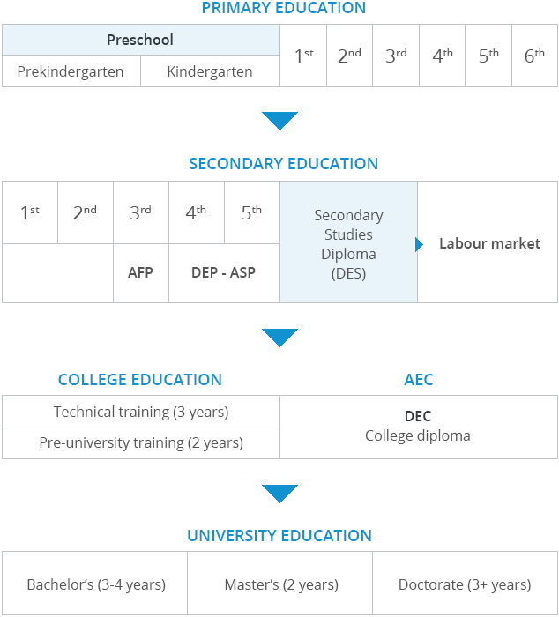
A Quebec / Canada Perspective

Slide 3
Rehabilitation Centres
Mostly sensory and motor disabilities
< than 10% of students with disabilities
Transition committees
Limited input from educational sector
Technology training specific to disability
Government approved and funded technology

Slide 4
Secondary School Experience
Individualized Education Plan
Transition component
Assistive technology as accommodation
Few assistive technology specialists
Device and software property of school
Ministry approved software
Notes:
Alt text will read: The medical model and the social model can be integrated to result in an interactional model. One example of an interactional model is the Disability Creation Process model that was developed and is used in Quebec. The theoretical framework of the social model has led to the development of the Universal Design for Learning (UDL) model.

Slide 5
Transition Programs to Postsecondary / Tertiary
Duration
1 day to week long
Limited reference to assistive technology
Need to ask
How well are they attended?
Are they cost effective?
Are they useful?

Slide 6
Alternatives
On-Line to Success¹
4-week on-line course
Transition Resource Guide for Students with Disabilities²
Provincial (AQEIPS) and National (NEADS) student organizations
Make reference to assistive technology
Notes:
Survey audience re their job/position. + Explain Cegep.

Slide 7
Student Testimonial
“I found that one of the biggest issues when I switched from high school to college was a difference in the services.
High schools use different platforms, such as Google Docs, to do their work on and hand in, whereas my college used Word.
In my high school I used programs like Google Read and Write, scribes, etc. and in college I use Dragon Naturally Speaking.
Depending on how long a student has used their technology, it can be tedious to learn and adapt to a new technology.”

Slide 8
Adaptech findings
Students with disabilities
Prefer to use mainstream technology³
Preferences in teachers’ use of technology
No significant difference from students without disabilities⁴
Students don’t like multiple platforms⁵
Not all teachers show students how to use technology⁶

Slide 9
Transition to Work
Programs for non-graduates
E.g., TEVA
Internship programs
E.g., Human Resources Development Canada
Intersections and Connections conferences⁷
Specialized employment centres

Slide 10
Technology / Transition Summary
Primary & Secondary
School board purchased
School loaned
Ministry approved
Minimal training
Postsecondary / Tertiary
Student provides device
Institution loans software
Needs-based accommodation
Assistive technologist
Student
Rehabilitation
Government approved list
One time purchase
Only for some disabilities
Training integrated
Work
Multiple funding sources
Adapted work stations
Work related software
No training

Slide 11
Promising practices
Just-in-time
Video capsules
FANDI (Adaptech Research Network)
Mainstream tech & transition programs
E.g. 1st semester office
Accessible design & faculty awareness
UD paradigm
Development of accessible online courses

Slide 12
References
¹ https://www.queensu.ca/rarc/transition-programs-and-services/olts-stomp
² http://www.transitionresourceguide.ca/
³ Fichten, C., King, L., Amsel, R., & Vaikla-Poldma, T., et at. (2013-2017). Les perspectives des étudiants et des professeurs sur l’excellence dans l’utilisation des TIC et du cyberapprentissage au collégial. Grant awarded by the Fonds de recherche du Québec - Société et culture.
⁴ Fichten, C. S., Nguyen, M. N., King, L., Barile, M., Havel, A., Mimouni, Z., Chauvin, A., Budd, J., Raymond, O., Juhel, J.-C., & Asuncion, J. (2013). Information and communication technology profiles of college students with learning disabilities and adequate and very poor readers. Journal of Education and Learning, 2(1), 176-188.
⁵ King, L., Jorgensen, M., Havel, A., Vitouchanskaia, C., & Lussier, A. (2015). College Students Speak Out: Coding Manual for their Teachers' Use of Computer Technology. Montreal, Quebec: Adaptech Research Network.
⁶ King, L., Jorgensen, M., Havel, A., Vitouchanskaia, C., & Lussier, A. (2015). College Students Speak Out: Coding Manual for their Teachers' Use of Computer Technology. Montreal, Quebec: Adaptech Research Network.
⁷https://www.mta.ca/uploadedFiles/Community/Student_services/Meighen_Centre/Resources/Transition/Transition%20to%20Employment%

Slide 13
Contact Us
Adaptech Research Network
www.adaptech.org
Alice Havel
ahavel@dawsoncollege.qc.ca
Catherine Fichten
cfichten@dawsoncollege.qc.ca
Laura King
laura.king@claurendeau.qc.ca

