Slide 1



Heads up! How Adaptech’s Research Findings Can Inform your Practice
Havel, A., & Wileman, S. (2021, May 4). Heads up! How can Adaptech’s research findings can inform your practice [Conference presentation]. CACUSS Accessibility and Inclusion Summit, Montreal, QC, Canada.
Alice Havel & Susie Wileman
Adaptech Research Network and Dawson College​
CACUSS Accessibility and Inclusion Summit, May 4, 2021

Slide 2

Agenda
We provide the data
We provide the questions
You participate in break out rooms
You come up with your responses
We all share our responses
Notes:
A lot of ‘you’ in the agenda,

Slide 3

Rules of Engagement
Question and answer
Chat
Raise hand and use the microphone
Breakout rooms (3x)

Slide 4

Who are we…?

Slide 5
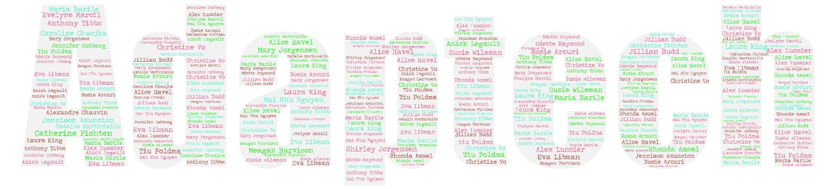
Who is…?

Slide 6
What is Adaptech?
Adaptech Research Network
  Team of teachers, professionals, students, researchers
  Conducts research on post-secondary students with a variety of disabilities
  Focus on information and computer technologies
  Based at Dawson College

Slide 7
About the Research
Empirical
Bilingual
International: 5 countries
Methods: qualitative, quantitative, archival
Research grants
  SSHRC (Social Sciences and Humanities Research Council of Canada)
  FRQSC (Fonds de recherche sur la société et la culture)
  MEES (Ministère de l'Éducation et de l'Enseignement supérieur)

Slide 8

Benefits of Applied Research
Gives stakeholders a voice
Expands knowledge base
Informs best practices
Provides data for lobbying
Guides policy

Slide 9

What do we Know?
9

Slide 10

Accessibility and Post-Secondary Education
Study: n = 1387 Cégep students¹
      241 (17%) "self-reported" a disability
  Most frequent disabilities reported
      LD / ADHD
      Mental health problems
      Chronic health problems
      Sensory and mobility related disabilities
  50% have multiple disabilities⁸
  2/3 do not register with accessibility services

Slide 11

Implications? (1)
Do our findings reflect what is happening on your campus?
Implications of the findings…?
Impact on accessibility and inclusion…?

Slide 12
Our take on this … (1)
Disability services statistics not reflective of institution’s realities
Multiple disabilities
    Accommodations based on functional limitations, not diagnosis
Self-report
    Documentation requirements can discriminate
Mental health most prevalent disability
    Suitable accommodations not obvious
Accommodations model excludes many students with diverse needs

Slide 13
Graduation and Perseverance²

Slide 14

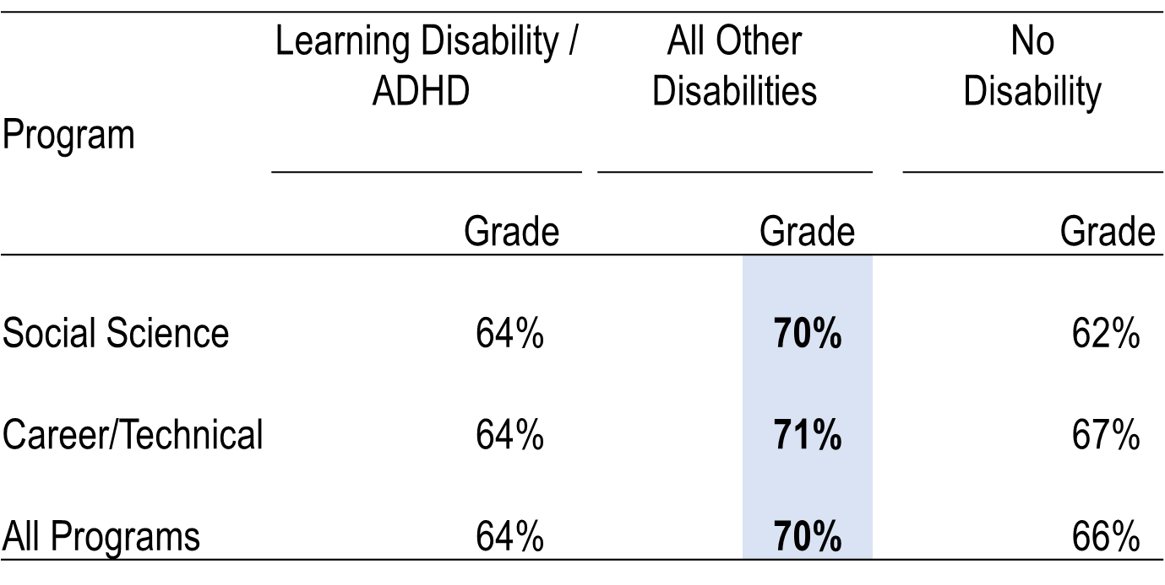
Grades
College 6-year archival study²

Slide 15
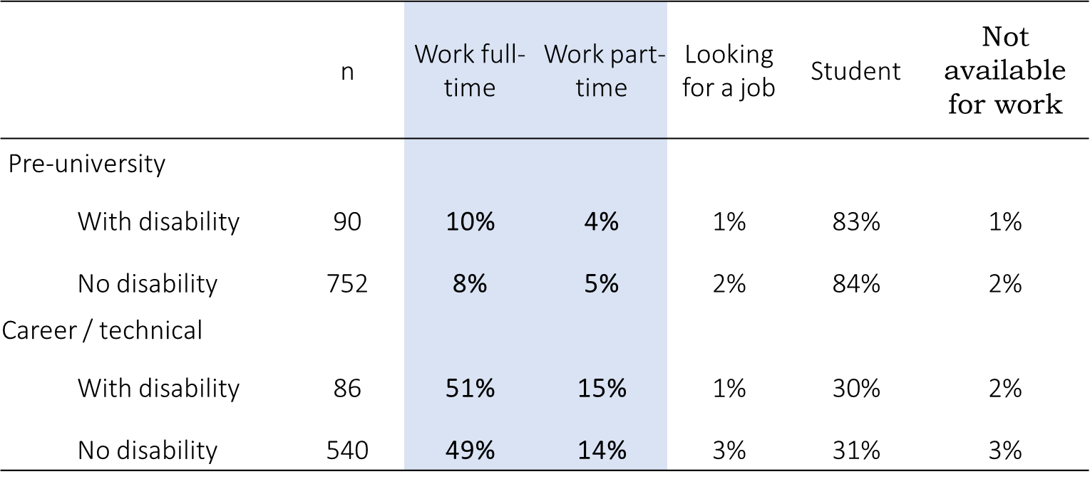

Employment
Graduates of 3 colleges 5-10 months after graduation³

Slide 16
Employment: 4 Years Later
Study n = 175 university students, 77 Cégep students⁴
4 years later
  193 graduated from original program
  59 dropped out. Some
    Switched to another program
    Another post-secondary institution
Employment
  9% not in the workforce
  Among those in the workforce 82% are employed
  Jobs (graduates) closely related to field of study

Slide 17

Implications? (2)
Do our findings reflect what is happening on your campus?
Implications of the findings…?
Impact on accessibility and inclusion…?

Slide 18
Our take on this … (2)
Graduate at same rate but 1 semester longer
    Notion of reduced course load
    Eligibility for awards
Grades as good as, if not better
    Meet same admission criteria
    Receive accommodations as needed
Find employment related to education
    Visible vs. non-visible disabilities

Slide 19
Our take on this … (2, Cont’d)
  Preferential registration into pedagogically inclusive learning environments
  Institutional responsibility
      Graduation vs. employment
  Accessibility beyond classroom to internships
  Employment policies for accessible workplace

Slide 20
Specialized ICTs Recommended by Experts⁵

Slide 21
Specialized ICTs used by Students⁵

Slide 22
ICTs and LD: Our Findings⁵
Students with LD DON’T use many of the ICTs recommended by experts
  Expensive
  Steep learning curve
      Insufficient training available on use of ICTs
Students mostly use mainstream technology
Students use smartphones and text messaging as tools

Slide 23
Use of Personal Technology in Class⁶

Slide 24
Do Faculty Need to be Experts?⁷

Slide 25

Technology that Worked Well
Presentation software
Notes posted online
Videos
Grades posted online

Slide 26
Technology that did not Work Well
Teachers’ use and knowledge of technology
Presentation software
Online communication
Performance of technology at school

Slide 27

Implications? (3)
How do our findings reflect what is happening on your campus?
Implications of these findings…?
Impact on accessibility and inclusion?

Slide 28
Our take on this … (3)
Mainstream technology preferred by students
    UD features in ease of use, etc.
    No longer an accommodation
Integration of mobile technology into pedagogy
    Inclusion of mobile technology into classroom activities
    Demonstration of useful tools
Faculty don’t have to be experts
    If use it, do it well
    Only use it if has purpose

Slide 29
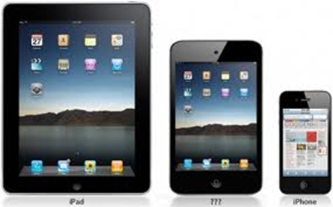
Our take on this … (3, Cont’d)
Use of mobile technology might increase engagement
Mobile technology can facilitate multiple means of
    Representation
    Expression

Slide 30
Covid-19 Pandemic – Method⁸
Goal
  What technologies are used to do schoolwork
Method
  163 students with disabilities
  74 students without disabilities
  LimeSurvey

Slide 31
Covid-19 Pandemic - Results
Zoom – can include captions (“craptions”)
Google Docs – speech-to-text, collaboration
Microsoft Word – speech-to-text, grammar, spell check
Calendars – reminders, alerts
Microsoft Teams – transcription (with Stream)
Office suites (Google, Microsoft)
To do lists and notes (can work across platforms)

Slide 32
Covid-19 Pandemic - Conclusions
Most worked well
  For both groups of students
But
  Zoom had problems for over 1/3 of students
  Microsoft Teams: problems for ∼50% students with disabilities
  When problems, more for students with disabilities

Slide 33
Implications? (4)
What now?
Would love to know if these findings echo what’s happening in your institutions during the pandemic?
Notes:
Summary – many of you have responded with feedback re: Covid

Slide 34
Our take on this … (4)
Online courses have removed need for many accommodations
Accessibility issues for diverse learners an institutional concern
New diversity-related barriers have arisen

Slide 35
Research with a little ‘r’
Knowledge transfer
Deliverables
  Video clips
  Tip sheets
Adaptech.org

Slide 36
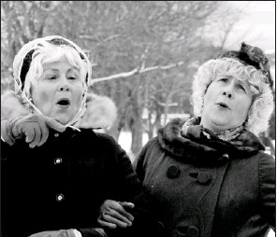
Goodbye and Thanks!
Adaptech Research Network: www.adaptech.org
Alice Havel: ahavel@dawsoncollege.qc.ca
Susan Wileman: swileman@dawsoncollege.qc.ca
Notes:
On behalf of Enid and Eulalia,
a.k.a. Cathy Jones and Mary Walsh in 22 Minutes

Slide 37
References
Fichten, C. S., Havel, A., King, L., Jorgensen, M., Budd, J., Asuncion, J., Nguyen, M. N., Amsel, R., & Marcil, E. (2018). Are you in or out? Canadian students who register for disability-related services in junior/community colleges versus those who do not. Journal of Education and Human Development, 7(1), 166-175. http://dx.doi.org/10.15640/jehd.v7n1a19
Jorgensen, S., Fichten, C. S., Havel, A., Lamb, D., James, C., & Barile, M. (2005). Academic performance of college students with and without disabilities: An archival study. Canadian Journal of Counselling, 39(2), 101-117.
Fichten, C. S., Jorgensen, S., Havel, A., Barile, M., Ferraro, V., Landry, M-E., Fiset, D., Juhel, J-C., Chwojka, C., Nguyen, M. N., Amsel, R., & Asuncion, J. V. (2012). What happens after graduation? Outcomes, employment, and recommendations of recent junior/community college graduates with and without disabilities. Disability and Rehabilitation, 34(11), 917-924. https://doi.org/10.3109/09638288.2011.626488
Fichten, C. S., Jorgensen, M., Nguyen, M. N., Budd, J., & Lesage, G. (2015, June 4-6). Students with disabilities in higher education: Four years later [Poster session]. 76th Annual Canadian Psychological Association Convention, Ottawa, ON, Canada.

Slide 38
References Cont’d
Fichten, C. S., Nguyen, M. N., King, L., Barile, M., Havel, A., Mimouni, Z., Chauvin, A., Budd, J., Raymond, O., Juhel, J.-C., & Asuncion, J. (2013). Information and communication technology profiles of college students with learning disabilities. Journal of Education and Learning, 2(1), 176-177. http://dx.doi.org/10.5539/jel.v2n1p176
Fichten, C. S., King, L., Jorgensen, M., Nguyen, M. N., Budd, J., Havel, A., Asuncion, J., Amsel, R., Raymond, R., & Poldma, T. (2015). What do college students really want when it comes to their instructors’ use of information and communication technologies (ICTs) in their teaching? International Journal of Learning, Teaching and Educational Research, 14(2), 173-191.
Jorgensen, M., Havel, A., Fichten, C., King, L., Marcil, E., Lussier, A., Budd, J., & Vitouchanskaia, C. (2018). "Simply the best" : Professors nominated by students for their exemplary technology practices in teaching. Education and Information Technologies, 23, 193-210. https://doi.org/10.1007/s10639-017-9594-1
Fichten, C., Jorgensen, M., Havel, A., Legault, A., & Budd, J. (in press). Academic performance and mobile technology use during the COVID-19 pandemic: A comparative study. Journal of Postsecondary Education and Disability.

