Slide 1
Using Alt Text and the Check Accessibility Features in PowerPoint
Roberta Thomson
Adaptech Research Network
Funding: Entente Canada Quebec (ECQ)

Slide 2
Welcome
Welcome to this short video on creating PowerPoints that are accessible to a diversity of users
We will look at how to use (Alternative) Alt Text and the Check Accessibility features in Microsoft PowerPoint
Alt Text is available in all Microsoft 365 products

Slide 3
Alt Text
Alt Text is a description which conveys meaning and context of a visual item
It is useful for those who use screen reading software, so they don’t miss critical information
Screen reading tools such as Microsoft Narrator, JAWS, NVDA, and Read Please read Alt Text aloud so people can better understand what is on the screen

Slide 4
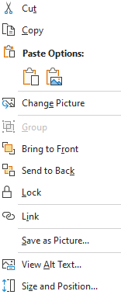
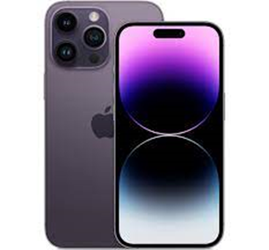
How to Add Alt Text
Let’s add Alt Text to the image on this slide
To do so, right-click on the phone image and click on View Alt Text
Microsoft often auto-generates alt text – this must be checked as it is often incorrect
Notes:
Add alt Text

Slide 5
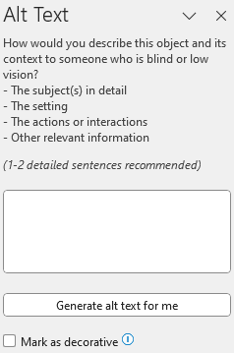
Adding Alt Text
After clicking on ‘View Alt Text’ a box will pop up where you can add the Alt Text description
If the image is simply decorative, put a checkmark in the “Mark as Decorative” box
Otherwise, add a 1-2 sentence description of the visual image into the box

Slide 6
Effective Alt Text
It is important to convey the content and the purpose of an image
Include the context, emotions on people’s faces, colours and relative sizes
Let’s give it a try

Slide 7
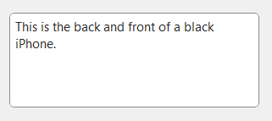
Inserting Alt Text
Using the image on this slide I will put a description in the Alt Text box
“This is the back and front of a black iPhone”
Once this is in the Alt Text box, you can go to your next slide

Slide 8
Locate Check Accessibility
Let’s look at Check Accessibility
This reviews all slides to let us know of anything that needs to change to make the PowerPoint more accessible
Click ‘Review’ on the Home toolbar and find ‘Check Accessibility’

Slide 9
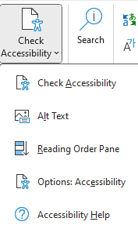
Check Accessibility
Click on the down arrow to explore the PowerPoint’s Accessibility
Options
Check Accessibility, Alt Text, Reading Order Pane, Options: Accessibility and Accessibility Help

Slide 10
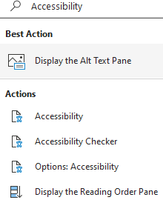
Review Accessibility
You can also type “Accessibility" into the search bar on top of the screen to Review Accessibility

Slide 11
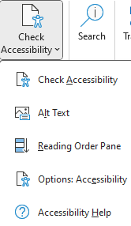
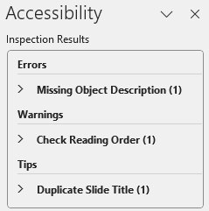
Review Accessibility
“Check Accessibility” will open the Accessibility Inspection Results in a pane on the right
It may show
Errors, Warnings, Tips and Intelligent Services

Slide 12
Accessibility Errors
Under Errors, click on the ‘>’ to see a dropdown list of Missing Object Description errors

Slide 13
Fixing Accessibility Errors
In this example, click on “Straight Arrow Connector”
Then click on ‘Add a description’ or ‘Mark as Decorative’
This takes you to the area on this slide to do this
“Orange arrow pointing to Recommended Actions”

Slide 14
Accessibility Warnings
Let’s look at the Warnings
There is 1 warning for Slide 15
Check Reading Order
Reading order is important because screen reading software reads sections in this order
You don’t want the body of the text to be read before the title, for example

Slide 15
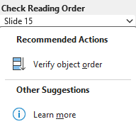
Check Reading Order
Click on the down arrow beside Slide 15
This shows the Recommended Actions
Click on Verify object order

Slide 16
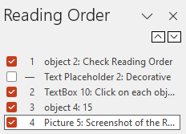
Check Reading Order
The Reading Order shows the order of the objects on slide 15
The number on the left shows the corresponding position
Correct the order by dragging the object to the place you want or use the small up/down arrows to move the selected object
You can check or uncheck a box whether it is decorative or not

Slide 17
Keep in Mind
Accessible slide formatting
No busy background
Use a sans serif font like Arial or Calibri
No italics
No more than 9 words and 7 lines per slide

Slide 18
Thank You
Thank you for viewing this short video on using Alt Text and the Check Accessibility Features in PowerPoint
Roberta Thomson, Adaptech Research Network
Funding: Entente Canada-Québec (ECQ)

