Slide 1
  Connecting the Dots: How Student Data on Their Use of ICTs Fits into a UDL Framework
  To download presentation:
  PowerPoint http://dc160.dawsoncollege.qc.ca/adapt2/
  Presentations/EdmontonConferenceJan26.pptx
  PDF
  http://dc160.dawsoncollege.qc.ca/adapt2/
  Presentations/EdmontonConferenceJan26.pdf

Slide 2






Connecting the Dots: How Student Data on Their Use of ICTs Fits into a UDL Framework
Laura King
In Collaboration with
Alice Havel, Catherine Fichten, Mary Jorgensen, Jillian Budd, Rhonda Amsel, Cristina Vitouchanskaia, Alex Lussier, Tiiu Poldma
Impact UDL, hosted by Athabasca University
January 30, 2016
Edmonton, Alberta

Slide 3
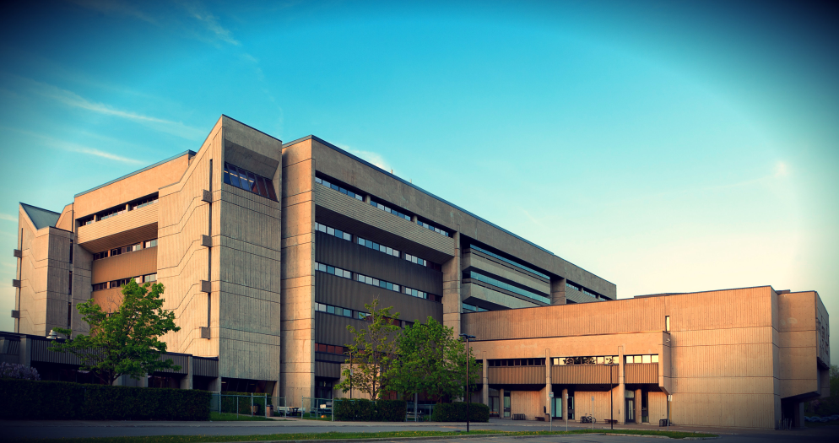
Presenter
Laura King
– Cégep André-Laurendeau
- Adaptech Research Network
laura.king@claurendeau.qc.ca

Slide 4
Learning Objectives
Identify ICTs that work well for students
Recognize ICTs that enhance access to Online and Blended Learning
Select one ICT change to implement

Slide 5
About the Research
  Student Demographics
    n = 311
    Gender
      F = 183 (59%)
      M = 126 (40%)
      Other = 2 (0.6%)
    Born outside of Canada
      n = 95 (30.5%)

Slide 6
Making the Survey UD
Online study
Accessible in alternative formats
  E.g., text-to-speech, large font
Simple language

Slide 7

Research Questions
Do you like courses where your teachers use technology?
Do you like courses where your teachers allow you to use your personal technologies in class?
Do your teachers allow you to use your personal technologies in class?

Slide 8
Research Questions (cont’d)
What technologies have your teachers used in class?
Which of these technologies worked well for you?
Which of these technologies did not work well for you?
Students’ suggestions for teachers use of technology

Slide 9
No Significant Differences
Born outside of Canada
Gender
Language of instruction
Disability

Slide 10

Connecting the Dots
What is the connection between ICTs and UD?
Are ICTs a gateway to UD?
Reflect / Interact

Slide 11
I Like Courses Where
Teachers Use Technology

Slide 12
Use of Personal Technology in Class

Slide 13
ICTs Frequently Used by Teachers
 | n | Worked well
Assignments posted online | 297 | 97%
Grades posted online | 298 | 99%
Presentation software | 298 | 98%
Course outline posted online | 296 | 96%

Slide 14
Technologies Frequently Used by Teachers (cont’d) – Rank Order
 | n | Worked Well
Online submission of assignments | 273 | 95%
Computer in a computer lab | 279 | 90%
Computer used to teach | 284 | 91%
E-mail | 261 | 87%
Course notes posted online | 271 | 97%

Slide 15

What Worked Well
Presentation software
Notes posted online
Videos
Grades posted online

Slide 16
What Did Not Work Well
Presentation software
Teachers’ use and knowledge of technology
Online communication
Performance of technology at school

Slide 17
Connecting the Dots
In online and blended courses students,
  Use ICTs
  Use their personal technology
  Receive and submit material online
  But not all students like online and blended classes…why might that be?

Slide 18
Tips
Using only one platform
Exploring platform features
Verifying the platform, web links
Posting in a timely and accurate manner
Focusing on content, not technology

Slide 19

Presentation Software
Keeping it simple
Discussing rather than reading
Caution using Prezi

Slide 20

Communication
Having guidelines for E-mails
Trying virtual office hours
Avoiding social media

Slide 21


Teaching Technology
Showing students how to
  Log onto the CMS
  Access publisher’s website
  Use common software (e.g. Excel)

Slide 22
Online Textbooks / Group Work
Online textbooks
  Availability of paper copies
Online group work
  Usual group work concerns
  Synchronous vs asynchronous
  Teaching online group tools
  Teaching online group work skills

Slide 23
Merci et à la prochaine!

