Slide 1
Unravelling The Night: Exploring the interplay between Neuroticism, psychological distress, and parasomnias in Post-Secondary Students
Huanan Liao
Psyc380
Liao, H. (2023, Janaury). Unravelling the night: Exploring the interplay between neuroticism, psychological distress, and parasomnias in post-secondary students [Invited speaker]. PSY380 Course at McGill University, Montreal, QC, Canada..

Slide 2
Background(1/3)
Kirwan & Fortune, 2021
N = 135; university students
Hypnic jerks (79.3%), nightmares (74.1%), sleep-talking (57.8%)
97.8% experienced at least one parasomnia symptom

Slide 3
Background(2/3)
Wang et al., 2023
N = 408; adolescent psychiatric patients
49.3% reported frequent nightmares
Distress
Frequency --------------------- Depression
Girls > boys

Slide 4
Background(3/3)
Kelly, 2020
N = 416; undergrads
Ego strength predicted nightmares frequency above trait neuroticism and state distress.
W/o ES, Only distress predicted nightmares.

Slide 5
Methods(1/2)
Cross-sectional
N = 85; post-secondary students
Bilingual
Procedure

Slide 6
Methods(2/2)
Munich Parasomnia Screening Questionnaire (MUPS) (Fulda et al., 2008)
Eysenck Personality Questionnaire-Revised (EPQR) (Francis et al., 1992)
Sleep Symptom Checklist (SSC) (Bailes et al., 2007)

Slide 7
MUPS
Likert scale (0-6)
“Frightening dreams and nightmares”
“Talking during sleep”
“Leg or body twitches that occur suddenly and unintentionally when falling asleep, often with the sensation of falling”

Slide 8
EPQR
Yes or no
“Often feel fed up?”
“Would you call yourself a nervous person?”
“Are you a worrier?”
“Do you feel lonely?”
“Do you suffer from nerves?”
“Does your mood go up and down?”

Slide 9
SSC
Assess sleep quality, insomnia, sleep disorder, and psychological maladjustments (0-3).
“Anxiety”, “Depression”, “Poor emotional wellbeing”

Slide 10
Analyses
SPSS
Independent sample t-tests
Bivariate correlational analyses

Slide 11
Preliminary Results(1/3)

Slide 12
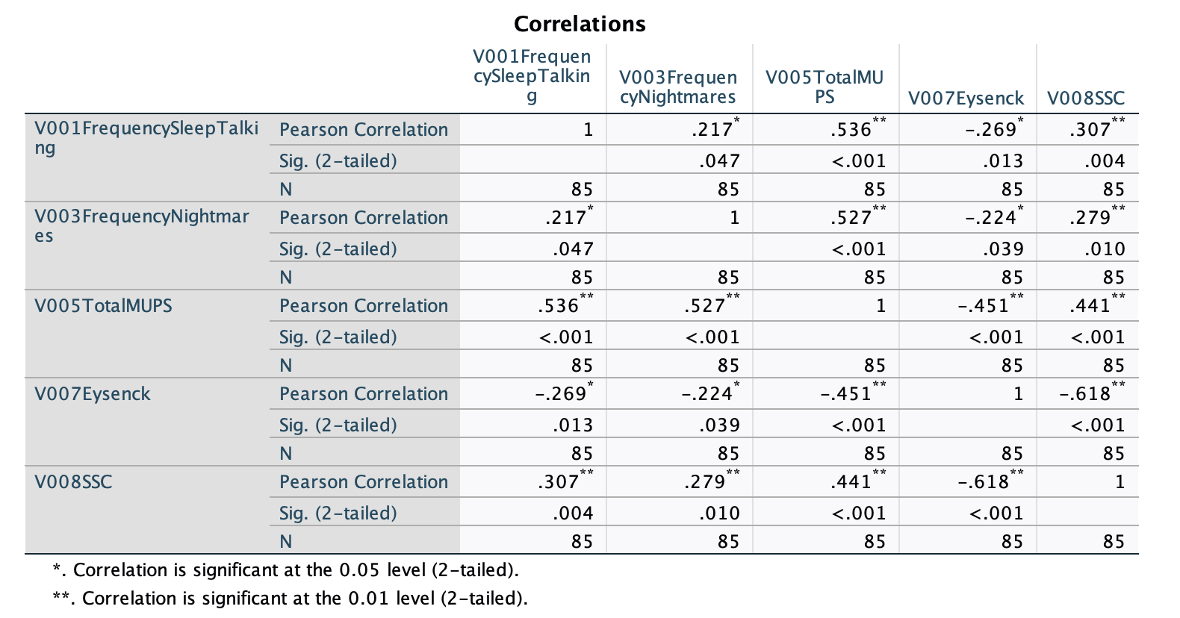
Preliminary Results(2/3)

Slide 13
Preliminary Resuits (3/3)

Slide 14
Discussion & Implications
Psychological maladjustments & Neuroticism ↑ frequency of parasomnias ↑
Comorbidities

Slide 15
Limitations
Snowball Sampling
Small sample size
Correlations =/= causation

Slide 16
Future directions
Longitudinal studies
Clinical intervention studies (e.g., addressing underlying factors in therapy)

Slide 17
Citations
Bailes, S., Baltzan, M., Rizzo, D., Fichten, C. S., Amsel, R., & Libman, E. (2008). A diagnostic symptom profile for sleep disorder in primary care patients. Journal of Psychosomatic Research, 64(4), 427-433.
Fulda, S., Hornyak, M., Müller, K., Cerny, L., Beitinger, P. A., & Wetter, T. C. (2008). Entwicklung und Validierung des Münchner Parasomnie-Screening (MUPS): Ein Fragebogen zur Erfassung von Parasomnien und nächtlichen Verhaltensweisen: A questionnaire for parasomnias and nocturnal behaviors. Somnologie-Schlafforschung und Schlafmedizin, 12, 56-65.
Francis, L. J., Brown, L. B., & Philipchalk, R. (1992). The development of an abbreviated form of the Revised Eysenck Personality Questionnaire (EPQR-A): Its use among students in England, Canada, the USA and Australia. Personality and individual differences, 13(4), 443-449.
Kirwan, E., & Fortune, D. G. (2021). Exploding head syndrome, chronotype, parasomnias and mental health in young adults. Journal of Sleep Research, 30(2), e13044.
Kelly, W. E. (2020). Nightmares and ego strength revisited: Ego strength predicts nightmares above neuroticism and general psychological distress. Dreaming, 30(1), 29.
Wang, Z., Zhang, K., He, L., Sun, J., Liu, J., & Hu, L. (2023). Associations between frequent nightmares, nightmare distress and depressive symptoms in adolescent psychiatric patients. Sleep Medicine, 106, 17-24.

