Slide 1
Detour Ahead: Overcoming Roadblocks to Educational Technology Use in College Teaching
Alice Havel, Rafael Scapin, Ph.D.
In Collaboration with
Mary Jorgensen, Catherine Fichten, Laura King
Presentation at the 37th AQPC Symposium
Montréal
June 6-8, 2016

Slide 2
Research Overview
Examined and compared student and faculty perspectives on use of ICTs
311 students from 1 English and 1 French language Cegep
114 of the professors nominated by students for excellent use of ICTs

Slide 3
Method
Students
Online questionnaire
Experiences with technology in cegep
Technologies professor used
What works well for them
Nomination of professors
Professors
Semi-structured interview
Checklist of technology used

Slide 4
Student Characteristics
Sex
Female : n = 183 (59 %)
Male : n = 126 (40 %)
Age : average = 20.50
Program of Study
Pre-university : n = 210 (68 %)
Technical / career : n = 94 (31 %)
Notes:
Survey audience re their job/position. + Explain Cegep.

Slide 5
Professor Characteristics
Language of Cegep:
English (54%)
French (46%)
Sex: Female (40%), Male (60%)
Program:
Social science (34%)
Science (37%)
Arts (28%)

Slide 6
Value of Research
Findings need to be accessible
Impact on daily teaching
Collaborative effort
Solve practical problems

Slide 7
I Like Courses Where Professors Use Technology

Slide 8
Findings and Possible Solutions

Slide 9
#10 : Attendance Records Online
Professors used – 59%
Worked well for students – 90%
Comments
Professors
Students should already know
Time consuming
Notes:
Canada-wide project
Inadequate funding for both on and off campus
Cross use technoligies:(i.e., technologies intended for students with one type of disability used by students with a different disability)
General use – students were using general use products as assistive aids like a casio tape recorder (e.g., tape recorder)
Professors noted that pedagogical practices useful for students with disabilities are good pedagogical practices in general

Slide 10
#10: Possible Solutions
Use the online app (iOS/Android) (smartphone/tablet) for either Lea or Moodle to take the attendance.
https://play.google.com/store/apps/details?id=com.skytech.omnivoxmobile&hl=en
https://itunes.apple.com/ca/app/omnivox-mobile/id721913649?mt=8
https://download.moodle.org/mobile/

Slide 11
#9 : Use of Clickers
Professors used – 17%
Worked well for students – 73%
Comments
Professors
Inconvenient to pick up and return
Sometimes they do not work
Despite this, on faculty wish list

Slide 12
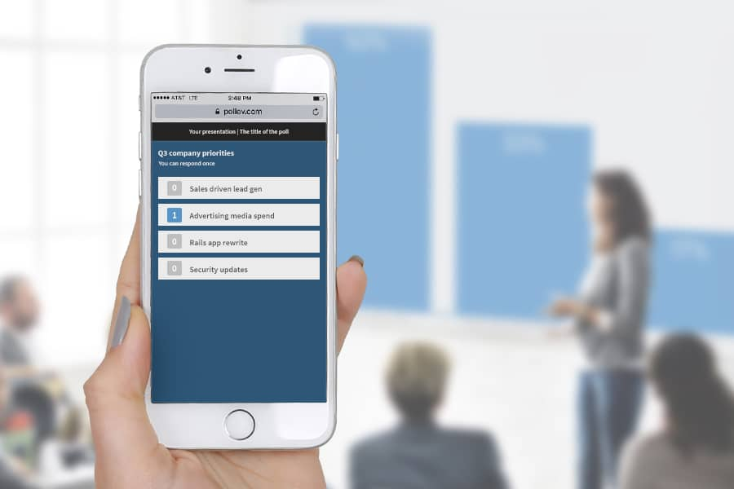
#9 : Possible Solutions
Use an online (web-based) clicker solution, like Poll Everywhere:
https://www.polleverywhere.com/

Slide 13
#8 : Use of Smart Board
Professors used – 24%
Worked well for students – 78%
Comments
Professors
On faculty wish list (not readily available)
Lack of knowledge about how to use
Students
Still want conventional course notes

Slide 14
#8: Possible Solutions
Creation of an Active Learning Community of Practice
Sharing best practices
Training
Keep class notes on a LMS (Moodle/Lea) or send them via email

Slide 15
#7: Online Testing
Professors used – 39%
Worked well for students – 89%
Comments
Professors
Concerns about cheating
Extended time accommodations

Slide 16
#7: Possible Solutions
Use a software to block access to external websites (LanSchool)
Shuffle questions and choices (when using Moodle quizzes)
Check with publishers for “accessible tests”

Slide 17
#6A: Use of E-mail
Professors used – 99%
Worked well for students – 87%
Comments
Students (Worked well BUT)
Delay in response
Too many different means of communication
Too many e-mails
Large files difficult to send

Slide 18
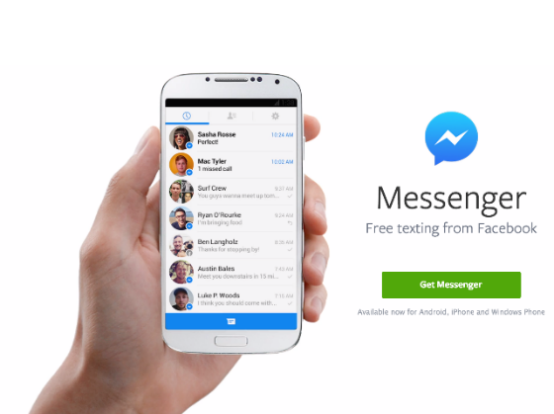
#6A: Possible Solutions
Create a private Facebook Community for your class
Use Messenger to communicate with students
Large files: put them in a cloud repository (Dropbox, OneDrive) and share the link

Slide 19
#6B: Virtual Office Hours
Professors used – 30%
Worked well for students – 86%
Comments
Students
Also wanted face-to-face office hours

Slide 20
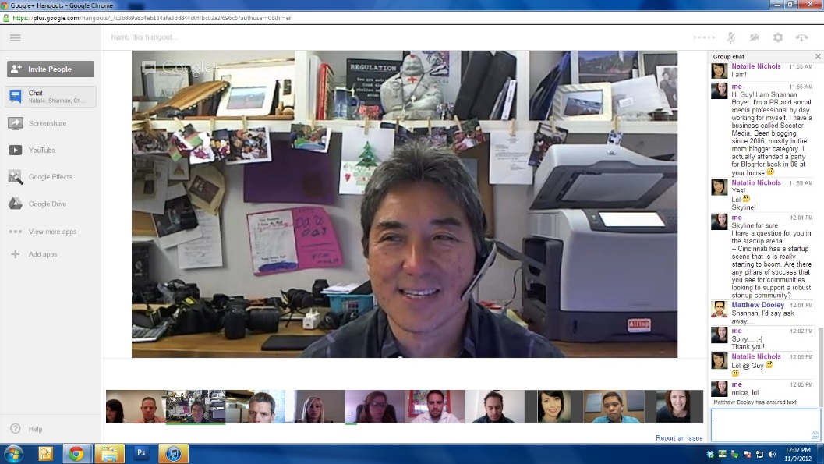
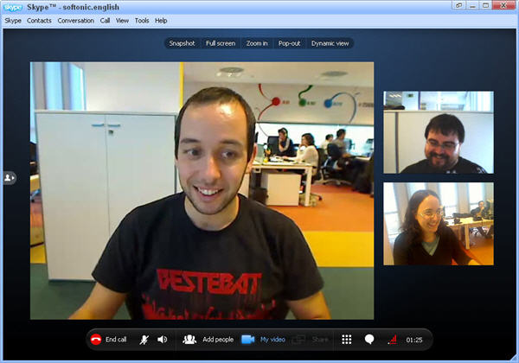
#6B: Possible Solutions
Blended Solution: use a web-based solution to connect to students at a distance and stay in your office for the face-to-face meetings. Google Hangout, Skype

Slide 21
#5: Peer Communication
Collaborative work online
Professors used – 25%
Worked well for students – 62%
Discussion forums
Professors used – 28%
Worked well for students – 53%
Comments – Students and Professors
Group work concerns

Slide 22
#5: Possible Solutions
Google Docs & Office 365: collaborative work in online documents
Facebook Community: online discussion and sharing. Facebook Messenger for online communication

Slide 23
#4: PowerPoint
Professors used – 91%
Worked well for students – 98%
Comments
Students (worked well BUT)
Cluttered slides
Difficult to read
Too much text, no images
Moved through slides too quickly

Slide 24
#4: Possible Solutions
Use online solutions: Google Slides, Office 365, Prezi
Training on how to create more effective presentations
Put presentations online so that students can follow it during the class and can download it if necessary

Slide 25
#3: Professors’ Knowledge of Technology
Student and professor concern re level of knowledge
Professors learned to use technology:
On their own – 53%
Workshops – 12%
Professors wanted:
Training videos / online tutorials
Training for Smart Board and clickers

Slide 26
#3: Possible Solutions
One-on-One Trainings for teachers
Workshops on Ed Tech to students
Communities of Practice: share best practices. Teachers inspiring teachers
Youtube edtech channels, newsletters, blogs (DawsonITE), my presentations at http://slideshare.net/rscapin

Slide 27
#2: Students’ Knowledge of Technology
32 % of professors showed students how to use course related technology
Professors in career / technical programs more likely to show than pre-university
Professors felt students overestimated their ability
Students felt professors should teach required skills

Slide 28
#2: Possible Solutions
Misconception: students are tech savvy. True?
Workshops on edtech content to students: useful apps, websites, cloud solutions
My presentations: https://www.slideshare.net/rscapin

Slide 29
#1: Students’ Use of Personal Technology

Slide 30
#1: Students’ Use of Personal Technology (cont’d)
Professors felt students used personal technology inappropriately
Never asked students purpose of use in class

Slide 31
#1: Possible Solutions
In conjunction with a BYOD policy, make students aware of how technology should be used in the classroom
Get feedback from students on how they feel in using technology in the classroom

Slide 32
Take Home Messages
Help is available:
Online resources
Campus technical support
Peer support
Not only what technology is being used, but how well it is used

Slide 33
Questions?

Slide 34
Contact Us
Alice Havel
ahavel@dawsoncollege.qc.ca
Rafael Scapin
rscapin@dawsoncollege.qc.ca

